Slide 1
LAI Enterprise Self-Assessment (LESAT)
Template presentation
for assessment respondents

Slide 2
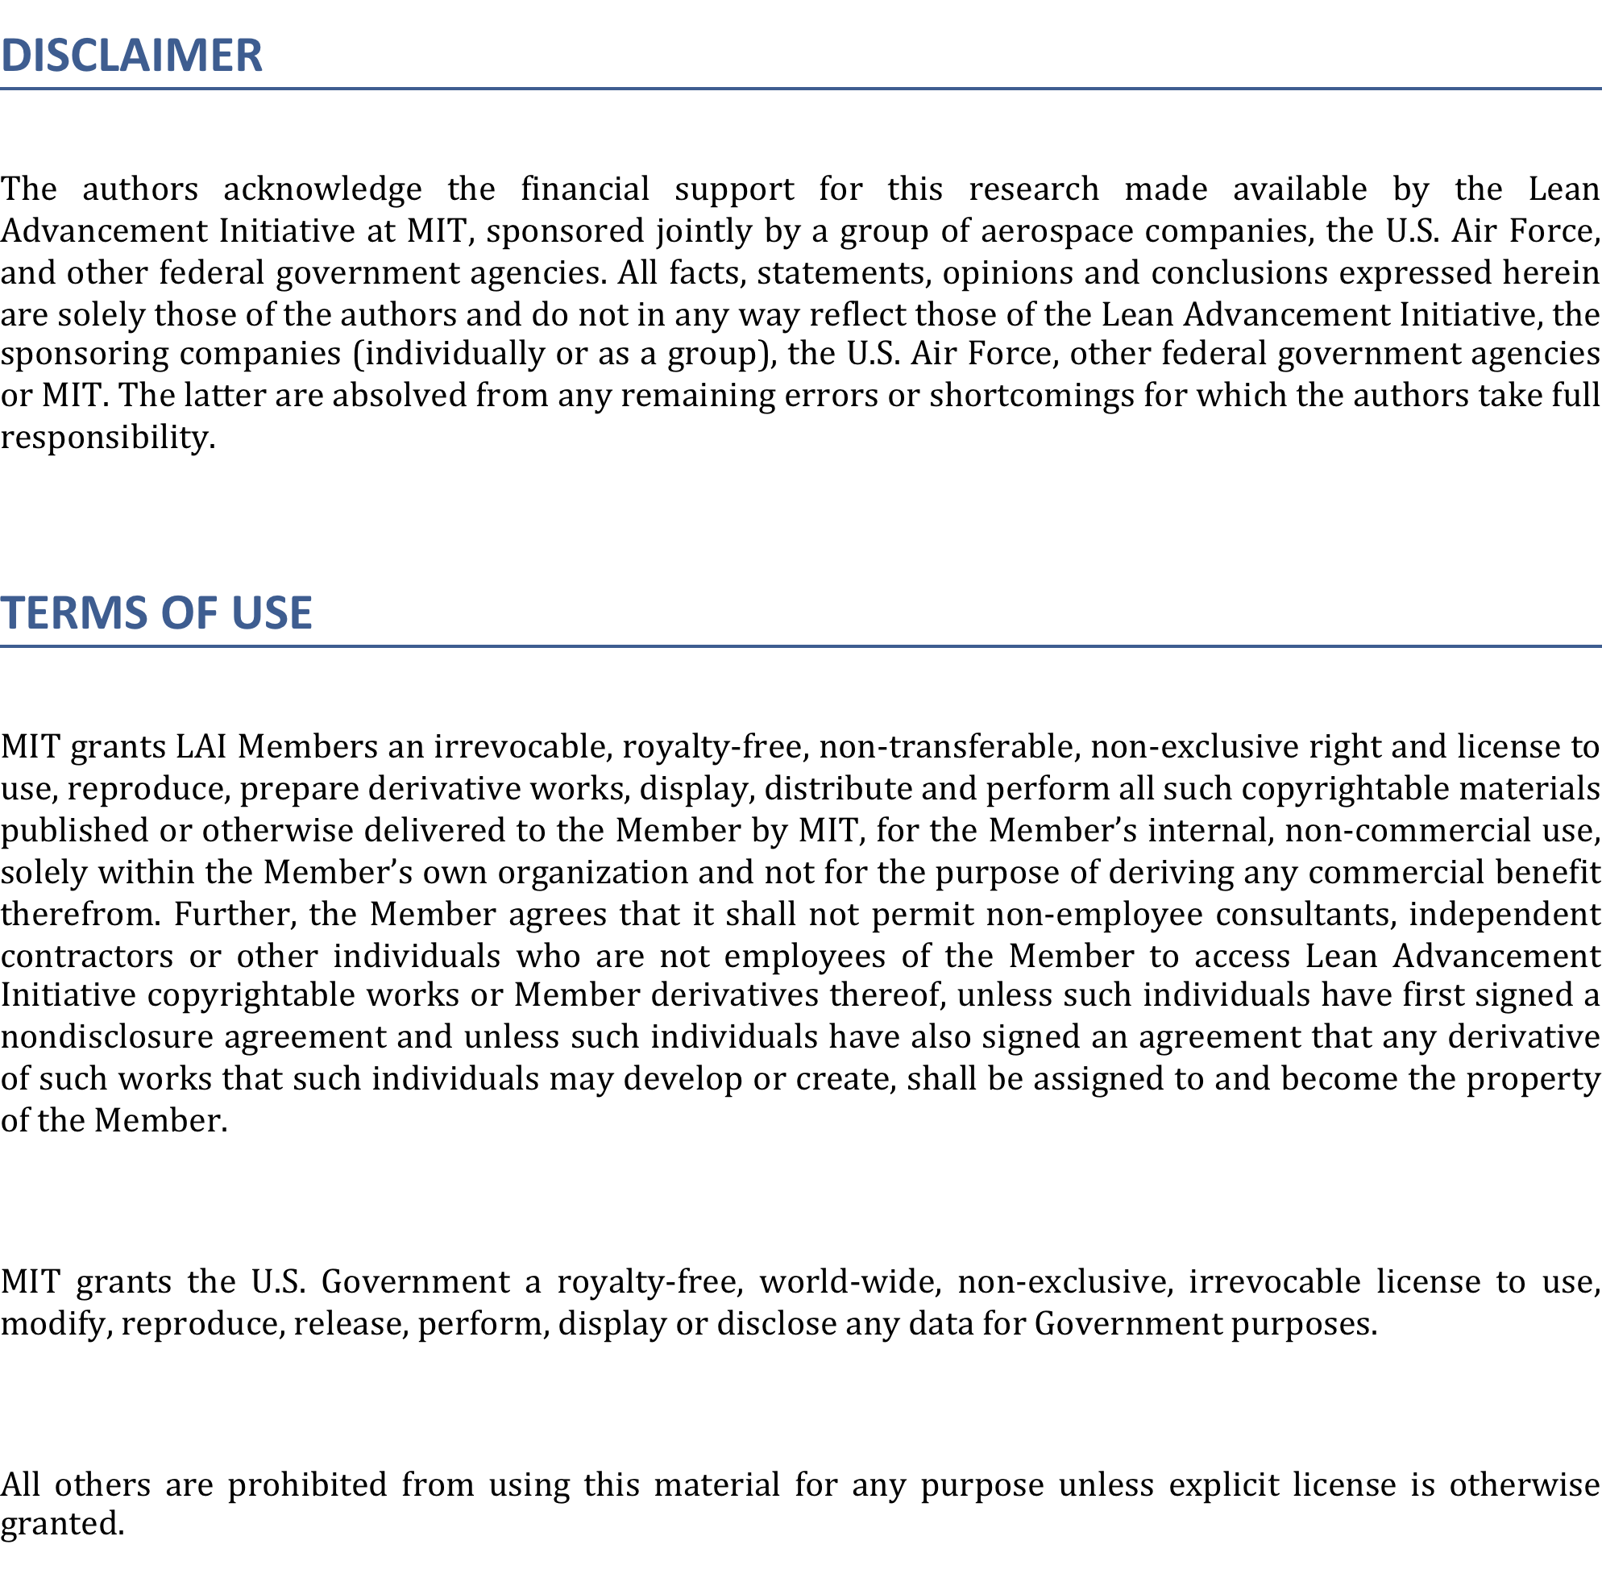

Slide 3
About this template
Intended audience:
  Assessment respondents
Objective:
  Ensure understanding of objectives and benefits of assessment
  Introduce assessment tool and process
Use:
  Modify the template as needed
  Maintain references to external sources

Slide 4
Outline
Enterprise concepts and principles
Assessment objectives and expected benefits
Respondents’ role
Assessment tool
Scope of assessment
Assessment process
Performing the assessment
Using assessment results
© 2012 Massachusetts Institute of Technology

Slide 5
Enterprise Concepts and Principles
WHY
TOOL
WHO
WHAT
HOW

Slide 6
Enterprise Transformation Principles
WHY
Adopt a holistic approach to enterprise transformation
Secure leadership commitment to drive and institutionalize enterprise behaviors
Identify relevant stakeholders and determine their value propositions
Focus on enterprise effectiveness before efficiency
Address internal and external enterprise interdependencies
Emphasize organizational learning
Ensure stability and flow within and across the enterprise
TOOL
WHO
WHAT
HOW
Source: Nightingale & Srinivasan, 2011
Notes:
Enterprise transformation principles define a mental model needed to transform an enterprise.
They evolved from what scholars and practitioners have written about the Toyota Production System, lean thinking, and lean enterprises, as well as from LAI’s experiences with transformation efforts.
Nightingale and Srinivasan (2011) define the seven enterprise transformation principles as follows:
Principle Adopt a Holistic Approach to Enterprise Transformation: The holistic approach to transformation builds on an understanding of the interactions and interdependencies within and across the enterprise and on the impact of transformation on the enterprise as a whole. It calls for identification of relevant stakeholders and they values, understanding of the core capabilities and competencies of the enterprise and whether the enterprise can deliver the required value.
Principle Secure Leadership Commitment to Drive and Institutionalize Enterprise Behaviors: Transformation must be driven, at the outset, from the highest levels of the enterprise and must have the full commitment of the senior leadership team. A process must then unfold to distribute that leadership commitment throughout the enterprise – from top to bottom – by communicating the strategic objectives of the enterprise and providing the rationale for the transformation efforts. Cultivating distributed leadership across all levels of an enterprise helps support the alignment of the enterprise with its strategic objectives and drives decision making to the lowest appropriate level.
Principle Identify relevant stakeholders and determine their value propositions: Enterprise is a network of stakeholders that contribute to and receive value from the enterprise. The common stakeholders of an enterprise are its shareholders, customers, suppliers, employees, and managers. A basic requirement for successful transformation is having an understanding of the enterprise value proposition and ensuring that the constructed value proposition is a true reflection of the values of its stakeholders.
Principle Focus on enterprise effectiveness before efficiency: Doing the right job and doing the job right: These dicta capture the notions of effectiveness and efficiency. An effective enterprise requires a value proposition that meets the current needs of stakeholders and is perceived to be able to meet their future needs. If you are able to execute at a lower cost (where cost is some function of resource utilization), yours is an efficient enterprise. By definition, an effective enterprise is, to some degree, efficient; it meets the value expectations of its stakeholders. The converse, though, is not always true. An efficient but ineffective enterprise will rapidly become extinct, but an effective enterprise – because of the value it provides – gains some time to become efficient.
Principle Address internal and external enterprise interdependencies: Every enterprise is a highly integrated system whose performance is determined by the degree of alignment among the major elements, including its key structures, policies, processes, and stakeholders. A successful transformation effort must account for interdependencies, both within the enterprise boundaries and across them.
Principle Ensure stability and flow within and across the enterprise: Both stability and flow are central to enterprise transformation effort. Stability provides the foundation for creating a baseline against which enterprise performance can be assessed. In the presence of stability, flow within the enterprise enables you to see the presence of bottlenecks and identify root causes to problems. As such, transformation must proceed at a slow, steady pace to ensure that the enterprise continues to operate in as stable a manner as possible.
Principle Emphasize organizational learning: Emphasizing organizational learning is as much about creating the context and culture to support a learning organization as it is about establishing the formal structures and policies that govern the learning process. It involves creating an infrastructure to capture the wealth of learning occurring every day, as part of the transformation, and to make sense of the vast amount of data and knowledge generated and collected. Established organizational learning culture and infrastructure enables stakeholders across the enterprise to exchange and deploy knowledge, best practices, better decision-making, proven transformation tools and techniques.

Slide 7
Enterprise Value Chain

Slide 8
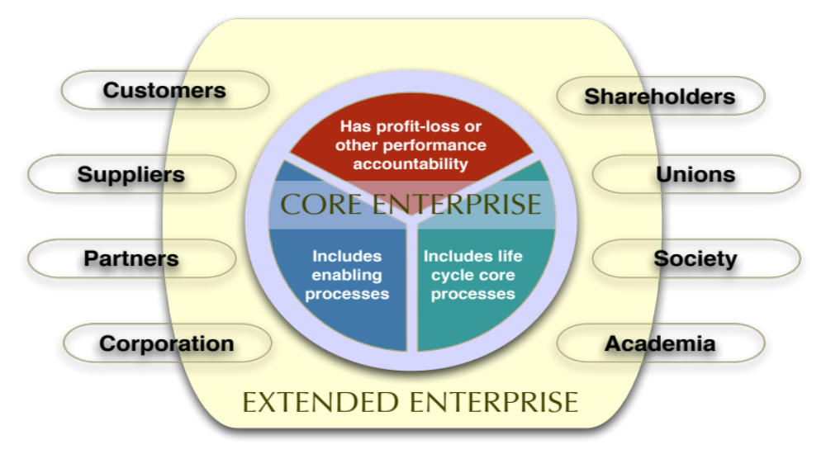
Scope of Assessment is Enterprise
WHY
TOOL
WHO
WHAT
HOW
Notes:
Scope of the assessment is the enterprise
Core enterprise refers to “entities tightly integrated through direct or partnering relationships”
Characteristics of an enterprise:
An enterprise should have profit/loss or another performance accountability;
An enterprise usually includes the lifecycle core processes, e.g. program management, requirement definition, product development, supply chain, production and support;
An enterprise usually includes the enabling processes, e.g. finance, human resources, information systems, etc.
Extended enterprise consists of the “less tightly coupled customers, suppliers, and government agencies”
Enterprise boundaries may not necessarily fit within the organizational boundaries or areas of direct responsibility of the enterprise leadership.
In an extended enterprise, the leadership may not have direct control over customers or suppliers, however the latter play important role in ensuring stable value delivery within an enterprise.

Slide 9
Objectives and Expected Benefits of Assessment
WHY
TOOL
WHO
WHAT
HOW

Slide 10
Assessment Objectives
WHY
[Add your objectives or modify below]
Generate input into enterprise transformation plan by:
  Assessing current enterprise capabilities,
  Assessing progress in implementation of earlier plans,
  Identifying performance gaps, and
  Prioritizing improvement actions
TOOL
WHO
WHAT
HOW
Notes:
Objectives of the assessment may vary depending on the needs of the organization
This slide provide an example of such objective

Slide 11
Assessment Allows
WHY
Identifying enterprise strengths and weaknesses
Identifying opportunities for improvement
Generating a future-state vision
Guiding transformation
Driving enterprise behavior
Enabling better decision-making
TOOL
WHO
WHAT
HOW
Notes:
Identifying enterprise strengths and weaknesses: The assessment identifies relative current maturity of the enterprise with regard to LESAT practices, where high maturity signals strength of the organization and low maturity signals weaknesses.
Identifying opportunities for improvement: When combined with the current maturity scores, the desired state scores provide insights into the importance of certain LESAT practices for the enterprise (a higher desired state score typically corresponds to higher importance) and the gap that the enterprise needs to close in order to achieve the desired state. Careful analysis of both the current scores and gaps allows for identification of improvement opportunities and prioritization of points of focus.
Generating a future-state vision for the enterprise: Identification of enterprise current strengths, performance gaps and opportunities for improvement provide solid ground for understanding of where the enterprise should be heading in the future and the goals that it should achieve.
Guiding transformation: By gaining insights on the current performance, past trends and desired future performance, decision-makers will be better equipped to design a transformation plan that meets the needs of the organization and will offer the highest benefit based on the values defined by all respondents during the assessment process.
Driving enterprise behavior: Knowledge and awareness of the respondents and enterprise leadership of the assessment results will likely motivate individuals to take actions in accordance with the needs and goals of the enterprise. It will increase the commitment of personnel to the transformation plan and to improving the organization, thus aligning enterprise behavior with organizational needs and with the goals of the transformation plan.
Enable better decision making: LESAT assessment data can be used to direct decision-making related to internal programs, training, improvement projects or organizational structure and focus decisions on those actions that will be most beneficial to the enterprise as a whole.

Slide 12
Benefits of Regular Ongoing Assessment
WHY
Internal benchmarking
Benchmarking across extended enterprise
Tracking progress in transformation journey
Tracking personnel cohesion and communication scores
Educating respondents
Tracking knowledge of enterprise principles
Assessment feedback to personnel
TOOL
WHO
WHAT
HOW
Notes:
Internal benchmarking: Baseline scores, established by performing an initial assessment at the beginning of the transformation process, provide a benchmark against which future performance can be compared.
Benchmarking across extended enterprise: Regular LESAT use across an extended enterprise offers opportunities for benchmarking across enterprises and setting widespread improvements goals or targets.
Educating the respondents: Often the first time use of the LESAT is a very educational opportunity for understanding the need to optimize the enterprise instead of specific functions. Often LESAT scores will go down as the respondents become more familiar with these concepts and are better able to assess their progress.
Tracking progress in transformation journey: Regular reassessment allows observing trends and tracking progress in the transformation journey. This information can be useful for refining transformation plans, shifting resource allocation, or other adjustments in order to improve the outcomes of the transformation plan.
Tracking personnel cohesion and communication scores: Regular reassessment can also offer insights into increasing personnel cohesion and team communication, by observing trends or shifts in the variance among respondents. Research has shown that variance naturally increases as practice maturity increases (Hallam, 2003).
Tracking knowledge of enterprise principles: As respondents become more familiar with enterprise transformation practices and concepts, this will be reflected in their scores and comments. For example, the comments collected for evidence and opportunities may provide more concrete examples of opportunities and evidence based on the respondents’ better understanding of enterprise practices.
Assessment feedback to personnel: Sharing the assessment results with the respondents will provide the respondents with the feedback that their knowledge and insights are of value and are used in order to understand the best course of action for the enterprise. This feedback has residual benefits in motivating greater involvement in future assessment processes, as well as a greater appreciation for the value of assessment.

Slide 13
Respondents’ Role
WHY
TOOL
WHO
WHAT
HOW

Slide 14
Honest opinion
Participate in discussions
Results will NOT be used for evaluation

Slide 15
Proposed Assessment Tool
WHY
TOOL
WHO
WHAT
HOW

Slide 16
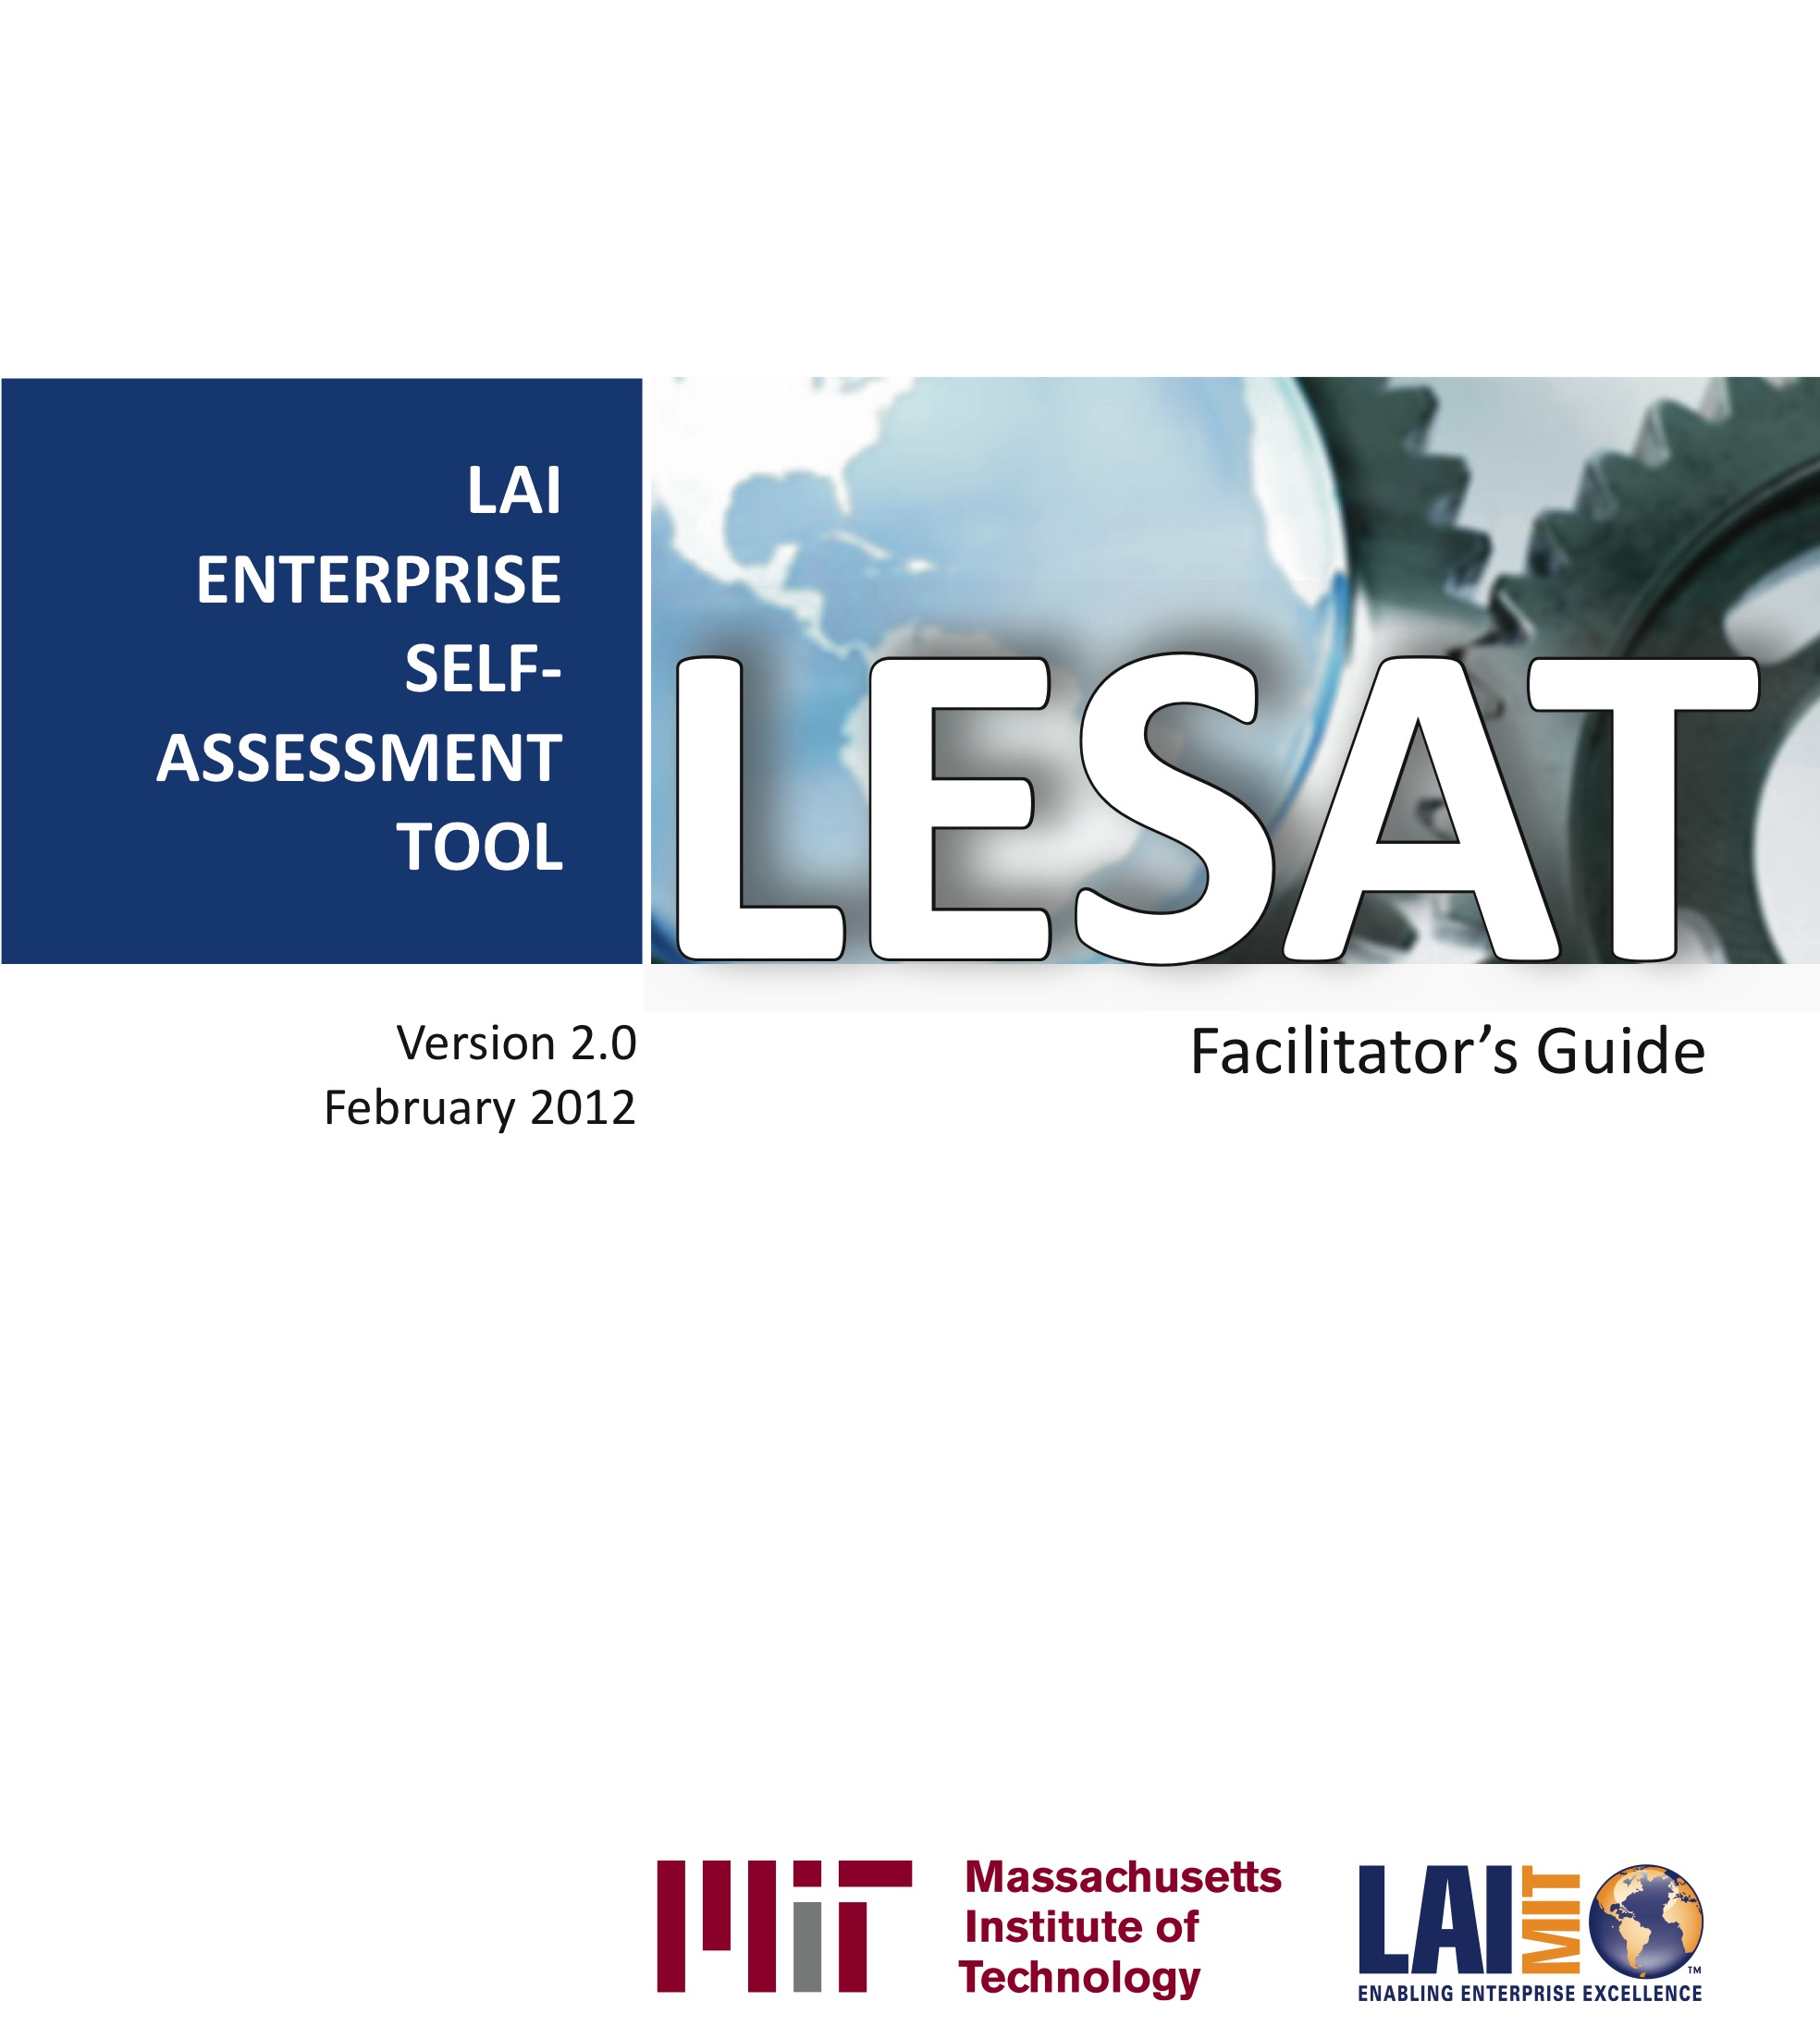
LAI Enterprise Self-Assessment Tool (LESAT)
WHY
Developed by joint industry / government / MIT team
Assesses enterprise “excellence” and its readiness to change
A capability maturity model
Supports both
  “As-Is” analysis
    And
  “To-Be” vision
Targeted at Enterprise Leadership Team
TOOL
WHO
WHAT
HOW
Notes:
[Change picture when the new cover is available]

Slide 17
LESAT Sections
WHY
Section I:
Enterprise Transformation/Leadership
Focus on enterprise practices and processes developed and maintained by leadership to achieve enterprise transformation
Section II:
Lifecycle Processes
Focus on processes that define the product lifecycle and result in value delivery to customer and other stakeholders
Section III:
Enabling Infrastructure
Focus on enabling processes that provide supporting services to other organizational units whom they serve as internal customers
TOOL
WHO
WHAT
HOW

Slide 18
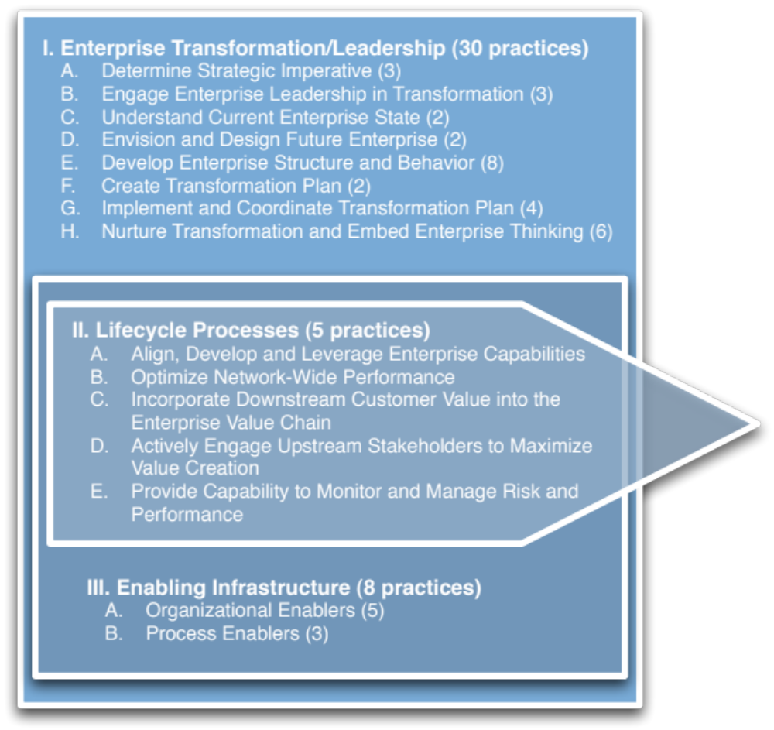
LESAT Practices
WHY
TOOL
WHO
WHAT
HOW
Notes:
LESAT comprises 56 enterprise practices divided amongst the three sections

Slide 19
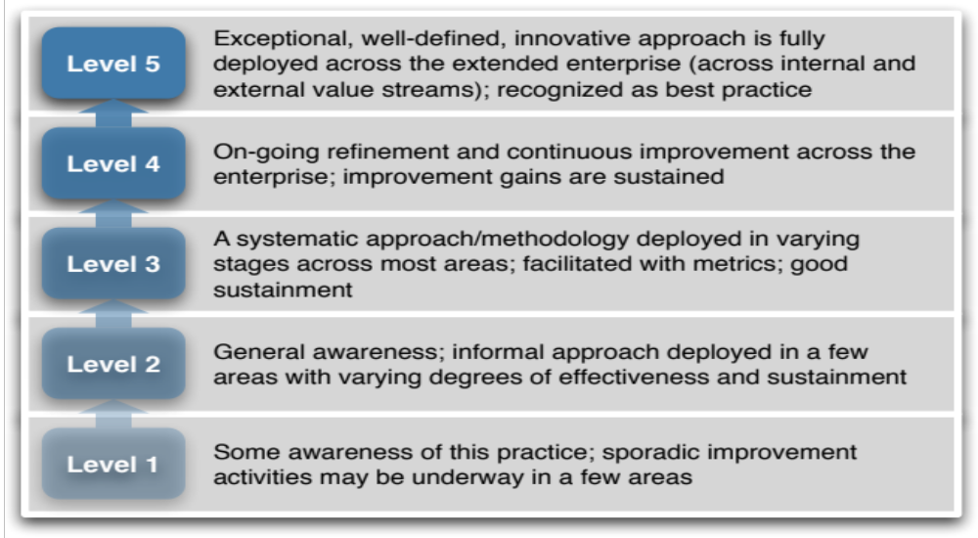
Generic Capability Maturity Level
WHY
TOOL
WHO
WHAT
HOW
Notes:
Each LESAT practice has five progressive maturity levels associated with it.
These levels range from least capable (Level 1) to world-class (Level 5).
These levels are intended to depict a progression in the capability of the enterprise relative to the particular practice being assessed.
The enterprise must have fully satisfied all elements of a particular level before it can progress to the next higher level.

Slide 20
Assessment Scope
WHY
TOOL
WHO
WHAT
HOW

Slide 21
Our Enterprise
WHY
[Define your enterprise, its boundaries and key stakeholders]
TOOL
WHO
WHAT
HOW
Notes:
Define your enterprise, its boundaries and stakeholders
This enterprise definition will be used throughout the assessment process
It is important to ensure that all respondents assess the capability maturity of the entire enterprise, and not just their function
Examples of an enterprise:
Business unit
Division
Entire company including extended enterprise supply chain
Extended enterprise including end-use customers
A major program or product development

Slide 22
Our Time Horizon
WHY
[Determine your assessment time horizon]
TOOL
WHO
WHAT
HOW
Notes:
The time horizon should be deemed appropriate for the purposes of the enterprise, i.e. be short enough to keep the enterprise focused and long enough to allow for proper planning and implementation of improvement actions.
A good approach is to use a 2-3 year period as a target for achieving the desired state.
All respondents must keep in mind this defined time horizon when assessing the desired state of the enterprise. This will ensure meaningful and comparable data.

Slide 23
Assessment Process
WHY
TOOL
WHO
WHAT
HOW

Slide 24
Assessment Timeline
[Day/Time] – Introduction and training
[Day/Time] – Assessment session
[Day/Time] – Discussion and analysis of results
[Day/Time] – Evaluation of assessment process

Slide 25
Performing Assessment
WHY
TOOL
WHO
WHAT
HOW

Slide 26
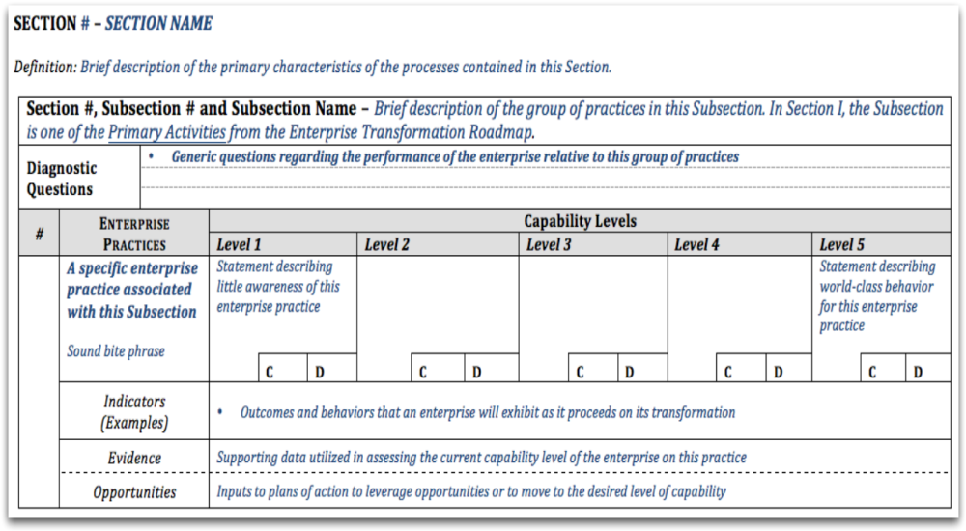
Enterprise Maturity Matrix Form
Notes:
[Add steps]

Slide 27
Section I

Slide 28
Section II

Slide 29
Section III

Slide 30
Using Assessment Results
WHY
TOOL
WHO
WHAT
HOW

Slide 31
Outline
WHY
Assessment objectives
Expected benefits
TOOL
Proposed assessment tool
WHO
WHAT
Assessment scope
HOW
Assessment participants
Assessment process
Requirements and next steps

Slide 32
We usually do well in assessing…
WHY
TOOL
Financial performance
Sales volume
Revenue
Operations performance
Production costs
Productivity
Operating costs
Financial ratios
Quality
Schedule
WHO
WHAT
HOW

Slide 33
It is much harder to track progress associated with broad change
WHY
TOOL
Soft metrics
Fuzzy metrics
“Gut feeling”
Difficult to assess
Intermediate progress in long-term task
Interdepen-dencies between tasks
“Good thing to do”
Corporate culture
Social interactions
Personal motivation
WHO
WHAT
HOW

Slide 34
During the transformation journey we often ask:
WHY
TOOL
How are we doing now?
How much progress have we made?
Where should we focus next?
WHO
WHAT
HOW

Slide 35
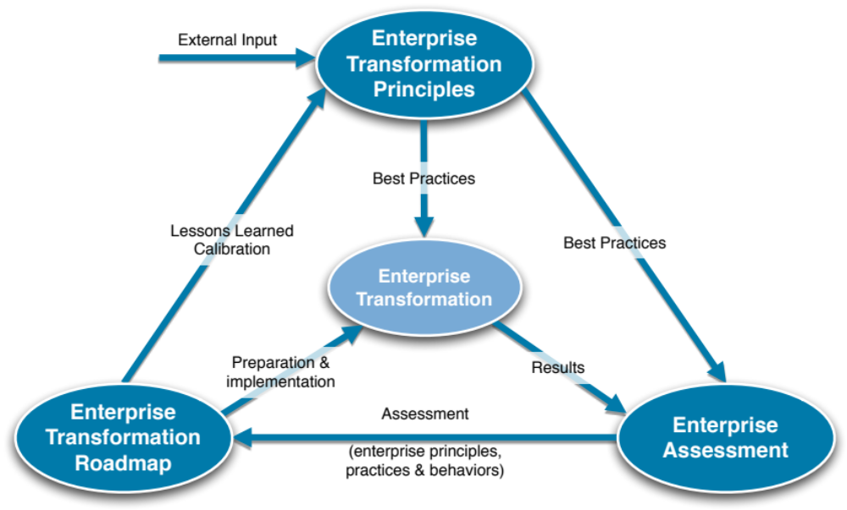
Assessment for Enterprise Transformation
WHY
TOOL
WHO
WHAT
HOW
Notes:
Enterprise assessment guides the transformation process
It is based on best practices associated with enterprise excellence, which are derived from enterprise transformation principles developed as a result of academic research and field experiences in enterprise transformation (Nightingale, 2009).
Assessment allows tracking progress in implementation of transformation plans, measuring current enterprise capabilities, envisioning a future state as well as assessing and prioritizing gaps between the current state and a desired state.
Assessment provides input into formulation of transformation plans

Slide 36
LAI Enterprise Transformation Roadmap
WHY
TOOL
WHO
WHAT
HOW
Source: Beyond the Lean Revolution, Amacon Press, August 2011, ISBN-13: 978-0814417096
Notes:
[Use your corporate enterprise transformation roadmap or the embedded one that was developed by LAI]
Enterprise Transformation Roadmap, or the Roadmap, was developed based on ten years of enterprise research to provide leadership with a decision aid for cultural, organizational and change management considerations in the strategic analysis and transformation of enterprises (Nightingale and Srinivasan, 2011).
The Roadmap recommends that enterprise transformation be approached in three main cycles: strategic, planning and execution. Enterprise transformation is an iterative process as the organization continuously adapt to the changing environment.
During the Strategic Cycle organizations establish the need for transformation and obtain leadership commitment.
The objective of the Planning Cycle is to formulate a vision of the state that the organization desires to attain, based on analysis of the current performance. During this cycle the organization creates a transformation plan and aligns structures and behaviors so that they enable attainment of the envisioned future state.
Once the transformation plan has been created and communicated throughout the organization, the Execution Cycle begins. This is the time to implement specific projects within the transformation plan and institutionalize improvements and lessons learned.

Slide 37
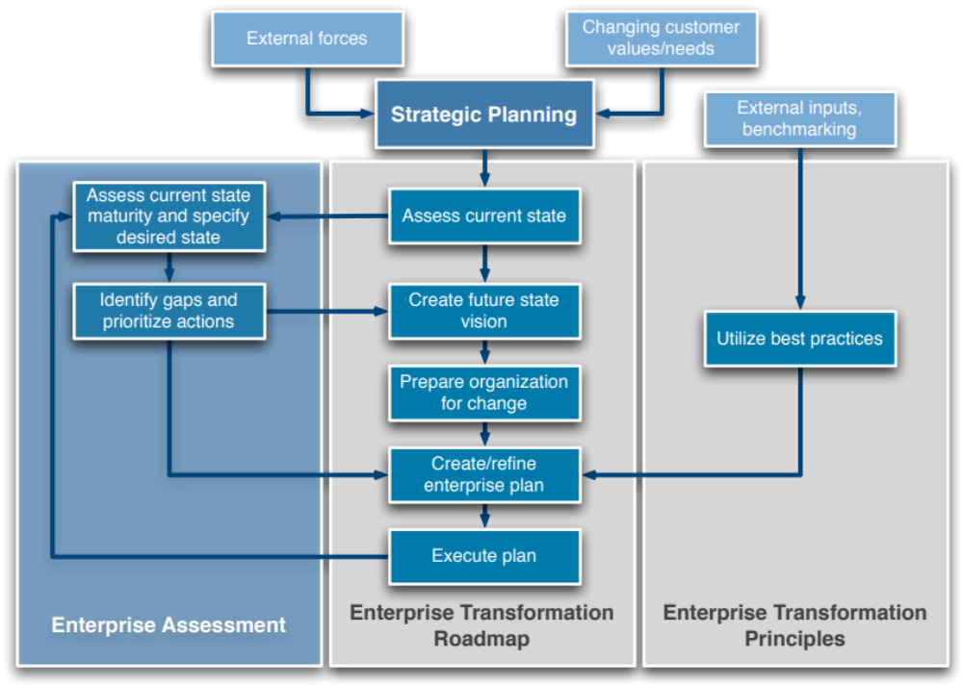
Assessment in Strategic Planning
WHY
TOOL
WHO
WHAT
HOW
Notes:
Enterprise assessment should be undertaken during the planning cycle of the enterprise transformation as the organization strives to understand its current state and identify what the future state should be.
By assessing both the current and future state of the enterprise, it helps identify gaps in current performance and priority areas where improvements are needed.
When analyzed properly, assessment provides valuable input into formulation of transformation plan and tracking progress in its implementation.

Slide 38
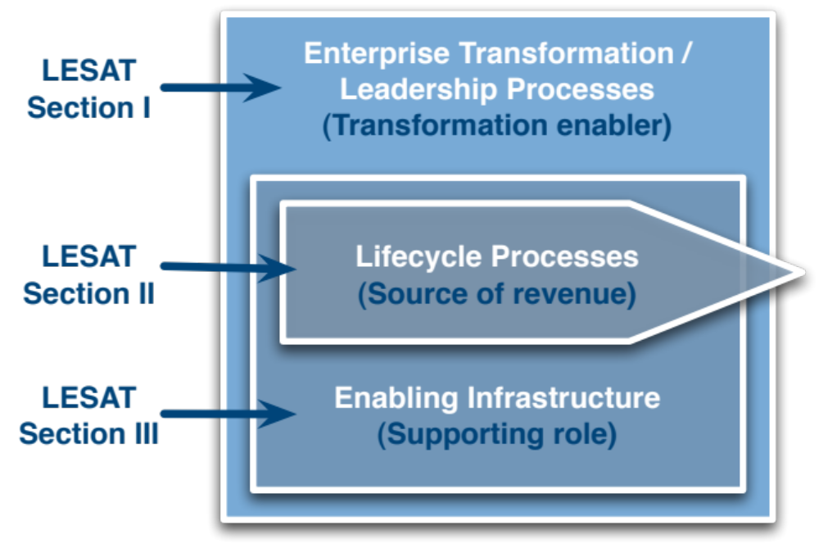
LESAT is consistent with
Enterprise Process View
WHY
TOOL
WHO
WHAT
HOW
Notes:
LESAT focuses on the three key enterprise-level processes, all of which must be transformed in order to achieve enterprise transformation:
Enterprise Transformation/Leadership Processes: These processes are developed and maintained by leadership to guide the activities of the enterprise. They cut across all of the entities that make up the enterprise. Section I of the LESAT assesses the leadership and their ability to achieve enterprise transformation.
Lifecycle Processes: These processes define the product lifecycle, from initial conception through operational support and ultimate disposal. They directly determine the value provided to customers and other stakeholders. The degree to which an enterprise is successful in making these processes effective and efficient is one measure of how well the enterprise delivers value to its customers and other stakeholders. Section II of the LESAT addresses the level of enterprise performance applicable to these lifecycle processes.
Enabling infrastructure processes: These processes support the execution of enterprise leadership and lifecycle processes. The enabling processes provide supporting services to other organizational units whom they serve as internal customers. Since they enable rather than directly result in enterprise success, they can be easily overlooked as sources of waste within the value stream. However, waste that is inherent in these processes can negatively impact both the enterprise as a whole and the lifecycle processes, and therefore they should be attacked vigorously. Section III of the LESAT assesses the extent to which enabling infrastructure supports enterprise performance.
LESAT Practices associated with each of the three enterprise processes are organized into three sections.

Slide 39
LESAT in Comparison with Other Assessment Tools
WHY
 | LESAT | Baldrige Prize | Shingo Prize | CMMI
Assessment mode | Self-assessment in support of transfor–mation planning | Award; can be adopted for internal assessment | Award; can be adapted for internal assessment | External assessment or self-assessment
Stakeholders | Enterprise leadership | Flexible | Flexible | Management
Criteria or information addressed | Enterprise practices | Quality and customer commitment | Toyota Production System and lean manufacturing | Best practices in process improvement
Information gleaned | Gaps and prioritized improvement areas | Areas for improvement and key principles | Successive adoption pyramid guides transformation | Gaps and improvement areas
Sectors | Designed for enter–prises who design, manufacturer and support products; recently applied to healthcare and services | Manufacturing, service, small business, health, education, non-profit | Designed for manufacturing; recently expanded to Operational Excellence | Designed for software development processes; adapted to wide range of business processes
TOOL
WHO
WHAT
HOW
Notes:
Baldrige prize: The Malcolm Baldrige National Quality Award is a program funded by the US Department of Commerce to recognize organizations that demonstrate performance excellence, as well as world-class product or service quality (NIST 2009). It is managed by the National Institute of Standards and Technology (NIST). The assessment criteria reflect a range of important organizational performance indicators that are used to drive a transformation plan, such as Leadership, Strategic Planning, Customer/Market Focus, Information & Analysis, Human Resource Focus, Process Management, and Business Results.
Shingo prize for operational excellence: The School of Business at Utah State University awards the Shingo Prize for Operational Excellence annually to companies that achieve world-class manufacturing (USU, 2009). The Shingo prize addresses a range of dimensions, including organizational culture, continuous process improvement and business results.
CMMI Appraisal: Developed by Carnegie Mellon University, Capability Maturity Model Integration (CMMI) models present an approach to process improvement with the goal of improving organizational performance. Initially designed for software development processes, CMMI is currently applied to a wide range of organizational business processes. CMMI appraisal involves assessment of organizational practices in eliciting and managing requirements, decision making, measuring performance, planning work, handling risks, and more.

Slide 40
Assessment Participants
WHY
TOOL
WHO
WHAT
HOW

Slide 41
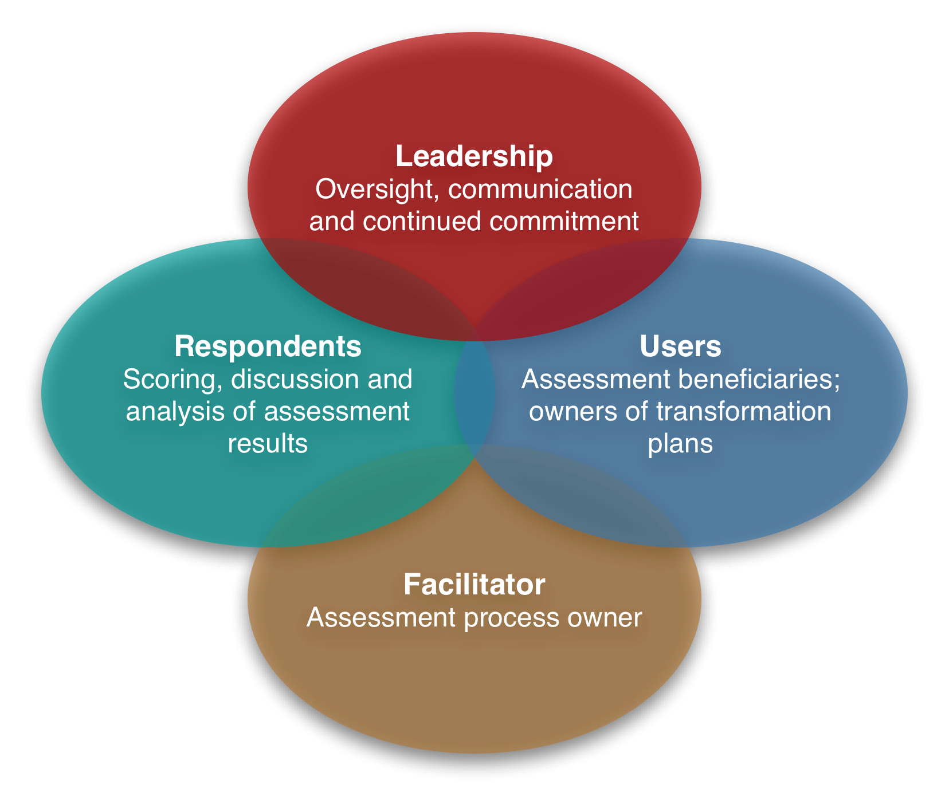
Roles of Assessment Participants
WHY
TOOL
WHO
WHAT
HOW
Notes:
Participants in the assessment process may act in different roles, such as enterprise leader, LESAT facilitator, user and respondent. These roles are not mutually exclusive, as various individuals may perform multiple roles in the assessment process. For example, enterprise leader is likely to be both assessment user and respondent. Some or all of the assessment users may be involved as respondents as well.
Roles and responsibilities may change depending on specific practices within the organization. Additional roles may be developed, such as assistant facilitators or analysts to provide support during the assessment and analysis of results.
Enterprise leaders provide oversight, communication and continued commitment throughout the whole process. Enterprise leaders typically have an overall responsibility for the performance of the enterprise to be assessed. Depending on the level of the enterprise, this may be a general manager of a company or program who directs along with his/her deputies. They are the primary beneficiaries of the assessment, as the enterprise leaders are accountable for the transformation process and development of the strategic and implementation plans.
LESAT Facilitator is the assessment process owner with end-to-end responsibility for and authority over the process. The role of the LESAT facilitator is very involved. Typically, this is not a full-time commitment, but rather a short-term responsibility. Ideally, it should be a permanent responsibility for facilitator, creating continuity between assessment cycles. The LESAT facilitator does not have direct functional control over other assessment stakeholders. However, it is important that the status of the LESAT facilitator is clear to all assessment stakeholders and that the facilitator is provided with sufficient authority to ensure the assessment remains on track.
Users typically are enterprise employees who benefit from assessment results and use them to develop transformation plans and carry out improvement activities. Users may include the enterprise leader, management and/or transformation champions, depending on the specifics of the organization.
Respondents participate in scoring, discussion and analysis of results.

Slide 42
Leadership Role is Essential
WHY
Provide continued oversight of assessment process, as part of transformation planning and implementation
Ensure regular communication regarding assessment process, results and transformation progress
Ensure continued support and commitment of participants to assessment process
Ensure availability of required resources
TOOL
WHO
WHAT
HOW

Slide 43
Eliminate Participants’ Biases
WHY
Participants’ biases decrease accuracy, reliability and usefulness of results
Ensure that assessment results are used:
  As a basis for productive discussion and formulation of transformation plans,
  NOT as evaluation of individual or departmental performance
TOOL
WHO
WHAT
Create environment that ensures accurate assessment and encourages open and frank discussion
HOW
Notes:
Examples of participants’ biases:
Self-report bias – The tendency to respond in a socially desirable way, e.g. because of the belief that responses may become visible to employer (Donaldson, S.I. and E.J. Grant-Vallone (2002). Understanding self-report bias in organizational behavior research. Journal of Business and Psychology, 17(2), Winter.)
Confirmation bias – The tendency to view information or systems in a way that confirms one's preconceptions.
Fear of managerial reprisal – Concerns that honestly expressing one's concerns or voicing criticisms will result in negative consequences, and hence tailoring responses to confirm manager's views (indirect confirmation bias) or being overly positive.
System-justification bias – The tendency to defend and bolster the status quo (fearing changes or alternatives). This is also called a status quo bias.

Slide 44
Assessment Time Horizon
WHY
LESAT assesses not only current state of the enterprise, but also its desired state
Assessment time horizon is the target date by which enterprise should achieve its desired state
Time horizon must be aligned with the enterprise strategic objectives
TOOL
WHO
WHAT
HOW

Slide 45
Overview of Assessment Process
WHY
Plan
Identify participants
Perform
Collect individual scores
Evaluate
Interpret assessment results
Determine timeline
Provide training
Discuss and analyze results
Evaluate assessment process
TOOL
WHO
WHAT
HOW
Notes:
Determine when the assessment will be performed: LESAT should be used as part of the strategic planning cycle.
If LESAT is used as part of the Enterprise Transformation Roadmap, the assessment should be performed during the first phase of the planning cycle (Understand Current State).
If LESAT is used autonomously, the assessment can be performed in as an input to the annual business planning exercise.
Determine how often the assessment will be performed: The assessment should be performed periodically, e.g. on an annual basis or as a new transformation cycle begins.

Slide 46
Timing of Assessment
WHY
[Determine when the assessment will be performed]
[Determine how often the assessment will be performed]
TOOL
WHO
WHAT
HOW
Notes:
Determine when the assessment will be performed: LESAT should be used as part of the strategic planning cycle.
If LESAT is used as part of the Enterprise Transformation Roadmap, the assessment should be performed during the first phase of the planning cycle (Understand Current State).
If LESAT is used autonomously, the assessment can be performed in as an input to the annual business planning exercise.
Determine how often the assessment will be performed: The assessment should be performed periodically, e.g. on an annual basis or as a new transformation cycle begins.

Slide 47
Allocate Responsibilities
WHY
[Define roles and responsibilities of assessment participants]
[Appoint LESAT facilitator]
TOOL
WHO
WHAT
HOW
Notes:
Define their roles and responsibilities:
Possible roles of participants in the assessment process are described above in the section on Assessment Stakeholders. Roles and responsibilities may change depending on specific practices within the organization. Additional roles may be developed, such as assistant facilitators or analysts to provide support during the assessment and analysis of results.
At this point, the focus is not on individuals, but rather on the approach to selecting participants
Appoint LESAT facilitator:
The LESAT facilitator should be an individual with sufficient expertise and influence in the organization, as the facilitator will be responsible for ensuring the timely and effective implementation of the assessment process. This requires knowledge of the assessment, as well as a certain level of authority to align resources and participants for a successful assessment.

Slide 48
Required Resources
WHY
[Identify required resources]
TOOL
WHO
WHAT
HOW
Notes:
The main resources required are people and their time. Assessment activities, including planning, training, scoring, discussion of results and development of improvement plans, will require time commitment from all participants.
Additional resources may be required depending on the needs of the organization. Such resources may include:
Funding for training of the facilitator and other participants,
Production of training materials and score sheets,
Travel expenses for participants,
In case of an automated assessment, personal computers for scoring and analysis of results.
Obtain commitment of stakeholders responsible for providing the resources. This concerns commitment of participants’ time, as well as recognition by enterprise leadership that participation in assessment is a value-added task.

Slide 49
Next Steps
WHY
[List next steps]
TOOL
WHO
WHAT
HOW

Slide 50
References
Hallam, C. R. (2003). Lean enterprise self-assessment as a leading indicator for accelerating transformation in the aerospace industry (Doctoral Dissertation). Cambridge, MA: MIT.
LAI Enterprise Self-Assessment Tool (LESAT). Version 2.0. Facilitator's guide. (2011). Cambridge, MA: MIT.
Nightingale, D. (2009). Principles of enterprise thinking. Second International Symposium on Engineering Systems. Cambridge, MA: MIT.
Nightingale, D., & Srinivasan, J. (2011). Beyond the lean revolution: Achieving successful and sustainable enterprise transformation. AMACOM.

