Slide 1
System Pathways Workshop Template
[date]

Slide 2
Overall instructions
This slide deck contains various modules that can be used for system mapping workshops.
Each module contains:
  A header slide coloured in red for easy locating in the slide deck. Some modules contain submodules, which have a header slide coloured in gray.
  Instructions slides (one for each submodule, if applicable) for the facilitator, to be removed for the actual presentation. They are coloured in blue. Instructions slides outline:
    The purpose of the module/submodule
    The slides in the module/submodule
    Guidelines for facilitating the module/submodule
  Slides for the actual workshop, either as templates or filled-in slides
    Text in [square brackets] are instructions or stand-in text, which should be replaced or removed for the actual presentation
Modules, submodules, and individual slides should be included or excluded to best fit your workshop requirements.
Each module is categorized as either “Introduction”, “Activity”, or “Wrap-up”. “Introduction” and “Wrap-up” are best suited to a single speaker presenting to an audience, whereas “Activities” require participation from the workshop attendees.

Slide 3
Modules included
Introduction:
  Workshop introduction
  Introduction to system mapping
  Showing a system map
Activities:
  Pathways
  Find yourself on the map
  Adding data
  Adding interventions
  Barriers and gaps
  Leverage points
  Collaboration and complementarity

Slide 4
Introduction
Module: Workshop introduction

Slide 5
Facilitator Instructions
Purpose of this module:
Introduce yourself and get the other groups in the workshop to introduce themselves, and outline the workshop objectives
Guidelines:
None
Slides in this module:
Facilitator introduction
Participant introductions
Workshop objectives

Slide 6
Introduction to [facilitator’s group]
Who are we?
  [description of your group]
What do we do?
  [brief description of what your group does, and how it uses system mapping]

Slide 7
Participant Introductions
[give each group in the workshop a minute or two to introduce themselves]

Slide 8
Workshop Objectives
[outline workshop objectives]

Slide 9
Introduction
Module: Introduction to system mapping

Slide 10
Facilitator Instructions
Purpose of this module:
Familiarize everyone in the workshop with systems thinking, systems mapping, and the specific systems mapping methodology.
Guidelines:
More time should be spent on this module if the participants are not familiar with the concepts, particularly the first two slides.
Slides in this module:
Systems thinking overview
System Mapping Guide
Example

Slide 11
Systems Thinking: Pathways from intervention to result
System thinking can help us to conceptualize
  pathways from intervention to result
  how different pathways interact
  where our organizations’ work interacts with that of other organizations
System maps help us to visualize these pathways and can help us to
  identify interactions among our work
  identify barriers, gaps & opportunities for facilitating positive change
  identify key indicators of change to measure early progress
Organization Y’s intervention
Relationship between actors
Indicator
Actor changes behavior
Interaction
Actor changes behavior
Enabling condition
Enabling condition
Gap/
Opportunity
Organization X’s intervention
Notes:
In this module, we ask you to build one or more “pathways” using a system mapping approach. In future sessions, we will utilize the same concepts to locate all our organizations’ work in a system map that depicts many of these interacting pathways. The approach will facilitate identification of interactions among all our organizations’ work and its collective impact on the Uganda agricultural system.

Slide 12
What characterizes complex systems?
In complex systems, like market systems and agricultural systems, processes of change:
Are often non-linear, involving feedback loops and other common system dynamics;
Typically have multiple contributing causes, and result from dynamic interactions between diverse causal factors, which may be planned or unplanned;
Typically involve causal mechanisms that operate at different levels of the system than the level where results or change is observed.
Activity design and monitoring and evaluating (M&E) must acknowledge and embrace this complexity – but how?
Notes:
Some of our core assumptions, from complexity science, about how change happens in complex systems include:

Slide 13
Why a systems perspective?
Outcomes in development are the product of complex systems
Maps can be used to represent any system, whether narrow or broad, concrete or abstract
Representing systems using maps helps to
  Promote collective understanding
  Create a common mental framing
  Communicate about the system
  Represent hypotheses about systems change
  Organize information about the system
  Collaborate in a "systematic" way
  Identify opportunities for new interventions
  Measure system "health" and dynamics
  Adapt to changes in the system
  Assess the impact of shocks

Slide 14
System Mapping Overview
A system map represents a mix of root cause analysis and a results framework, within the context of a broader sector
The map aims to reflect the status you desire or expect to see in the system
  key outcomes, and
  the pathways that enable key outcomes
You then use it to identify how reality falls short and to figure out why
The map will not be
  complete
  perfect
  static
There are many systems, and system maps – the map in front of you began with the agricultural market system and is expanding, with some complex systems represented abstractly as a cloud

Slide 15
Mapping Guide: Elements
Relationship
Relationship between actors
Definition: Relationships between actors are mapped where the quality of interaction between actors is important to enable behaviors or conditions, such as repeated business transactions or increased information sharing.
“Government and Donors/NGOs”
Key Outcome
Definition: A key outcome represents an important or desired outcome for the system. A key outcome could be any one of the basic system elements: behavior, relationship, or condition.
“Household members maintain bodily and mental well-being”
“Household has adequate financial resources”
Key outcome
Household Mindset
Condition
Definition: Conditions are attributes of the market environment that enable a behavior, relationship, or other condition. They are aspects of the system that cannot clearly be defined as a behavior or relationship.
“Health clinic is nearby”
“Water supply is reliable”
Definition: An opinion or perception held by the household which influences their behavior.
“Household has positive perception of savings groups”
“Household understands importance of accessing trained health personnel”
Mindset held by the household
Condition of the system
Government
Behavior
Definition: A behavior or activity carried out by the government.
“Government provides and maintains adequate transportation infrastructure”
“Government enforces bylaws for conservation”
“Local officials support livestock extension service provision”
Behavior
Definition: A behavior is an action or approach carried out by an individual or entity. The descriptions typically contain an active or passive verb (e.g. “provides”, “is aware of”, “improves”).
“Household maintains good sanitation practices”
“Donors/NGOs provide emergency assistance”
Actor engages in a behavior
Government engages in a behavior
Intervention
Definition: An intervention is a project or initiative being implemented by the development community that aims to influence the system. Color coded by organization.
“Organization X: Train agriculture extension workers”
“Organization X: Demonstrate water treatment”
Definition: An arrow connecting one item to another indicates that the former enables the latter. The arrows do not necessarily represent causation – an arrow merely means that an element facilitates another element or makes it more likely to exist.
Arrow
Organization X intervenes in Y

Slide 16
Mapping Guide: Clouds
Clouds are a way to simplify complex parts of a system that are not the main focus of the map
Sometimes, a cloud on one system map may be expanded in another system map
This does not mean the cloud is not important, just that it isn’t the main focus of the map
Representation on national market system map
Representation on Karamoja market system map
Other clouds in the Karamoja ag map:
Inputs Importing and Manufacturing
Financial and Business Services
Livestock Market
Household Resilience
Extension Services
Farmer Production Practices

Slide 17
Mapping Guide: Connections
A connection implies that one element enables the next one (not necessarily that it directly causes it). The element facilitates the next element, or makes it more likely to exist.
For example: accessing financial services and providing agricultural services may help enable the collector/trader to earn a profit, but obviously are not the only things that are needed.

Slide 18
Example
Better quality outputs for farmer
Quality retail input markets are Acceptable, Available, Accessible, Affordable
Wholesaler/ Dealer stocks quality agricultural inputs
Farmer purchases and uses quality inputs
Higher farmer income
Increased yield for farmer
Wholesaler/Dealer and Farmer
Organization X’s intervention

Slide 19
Introduction
Module: Showing a system map

Slide 20
Facilitator Instructions
Purpose of this module:
Introduce and familiarize everyone with a specific system map that will be used for the workshop.
Guidelines:
More time should be spent on this module if the participants are not familiar the system map. Conversely, this section can be kept relatively brief if everyone in the workshop has recently worked on this specific system map.
More slides should be used to go into more detail for specific parts of the system map, or to illustrate key concepts.
Sub-modules in this module:
What can you do with a map
How to read a map
Visualizing themes

Slide 21
Activities
Module: Showing a system map
Sub-module: What can we do with a map

Slide 22
Facilitator Instructions
Purpose of this module:
Introduce at a high level what can be done with system maps.
Guidelines:
Slides in this module:
Tool for collaboration / visualization
Identifying Leverage Points
Measuring change

Slide 23
What can we do with maps?

Slide 24
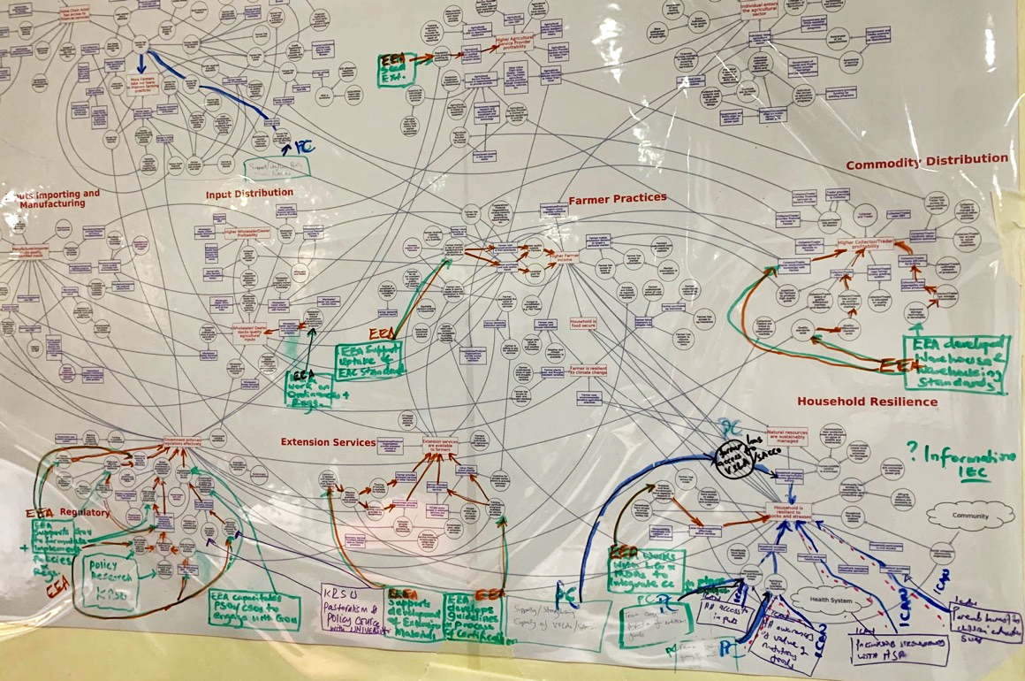
Tool for collaboration, visualization

Slide 25
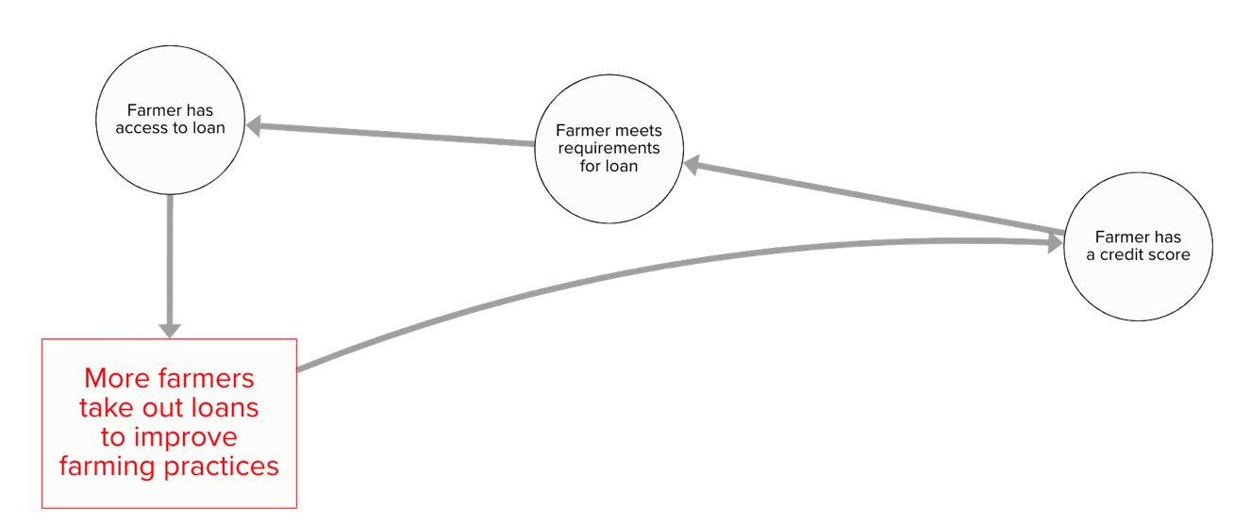
Identifying Leverage Points
Map the system
Find important change pathways
Select leverage points
Select outcome to change
Prioritize leverage points
An intervention acts on a leverage point, which could be
any of the system elements.
Intervention
Capacity building for financial institutions to create farmer profiles
Leverage
Point

Slide 26






Measuring change
Which parts of a vast, complex system to measure?
  Map the system and find the pathways that drive change
  Select key points along those pathways
    Outcome indicators
    Diagnostic indicators (including early, off-pathway)
What to measure?
  Adoption and expansion of desired behaviors and states
How to interpret data to understand system health?
  Assess system, subsystem, and pathway health
  Diagnose problems, show system-wide influence of success
Expanded to most others
Adopted by all directly targeted participants
Warning: this is complex!

Slide 27
Activities
Module: Showing a system map
Sub-module: How to read a map

Slide 28
Facilitator Instructions
Purpose of this module:
Introduce how to approach a system map.
Guidelines:
System maps can be complicated. This slide emphasizes how to break the map into approachable pieces.
Slides in this module:
How to read a map

Slide 29
How to read a map
Orienting with subsystems
  The entire system may be too expansive and complex to comprehend as a whole (e.g., our Uganda agricultural market system map)
  Subsystems are natural groupings of map elements that align with common constructs (e.g., our map aligns with the agricultural supply chain and its enabling environment)
Finding pathways
  Start with an outcome
  Ask the key question: what enables this?
  End with interventions (if your map has them) or a subset of behaviors, relationships, and conditions
Be ready for interconnections
  Subsystems may not be nicely isolated – you may want to visit other parts of the system to understand it
  There may not be a natural starting point for a pathway – there may be a loop
You can keep it simple
  Focus on the part of the map that captures your focus: element, pathway, subsystem, system
  Systems thinking does not require that you understand all interconnections, especially in early engagements

Slide 30
Activities
Module: Showing a system map
Sub-module: Visualizing themes

Slide 31
Facilitator Instructions
Purpose of this module:
Visualizing broad themes can help people engage with a system map at a high-level before diving into details.
Guidelines:
The slides in this submodule are all examples of how to show broad themes using overlays and labels in Powerpoint.
Slides in this module:
Resilience Map: Key concepts
Pathway: Education
Pathway: Conflict
Pathway: Land
Ag Market System Map: Key flows
Ag Market System Map: Key subsystems

Slide 32
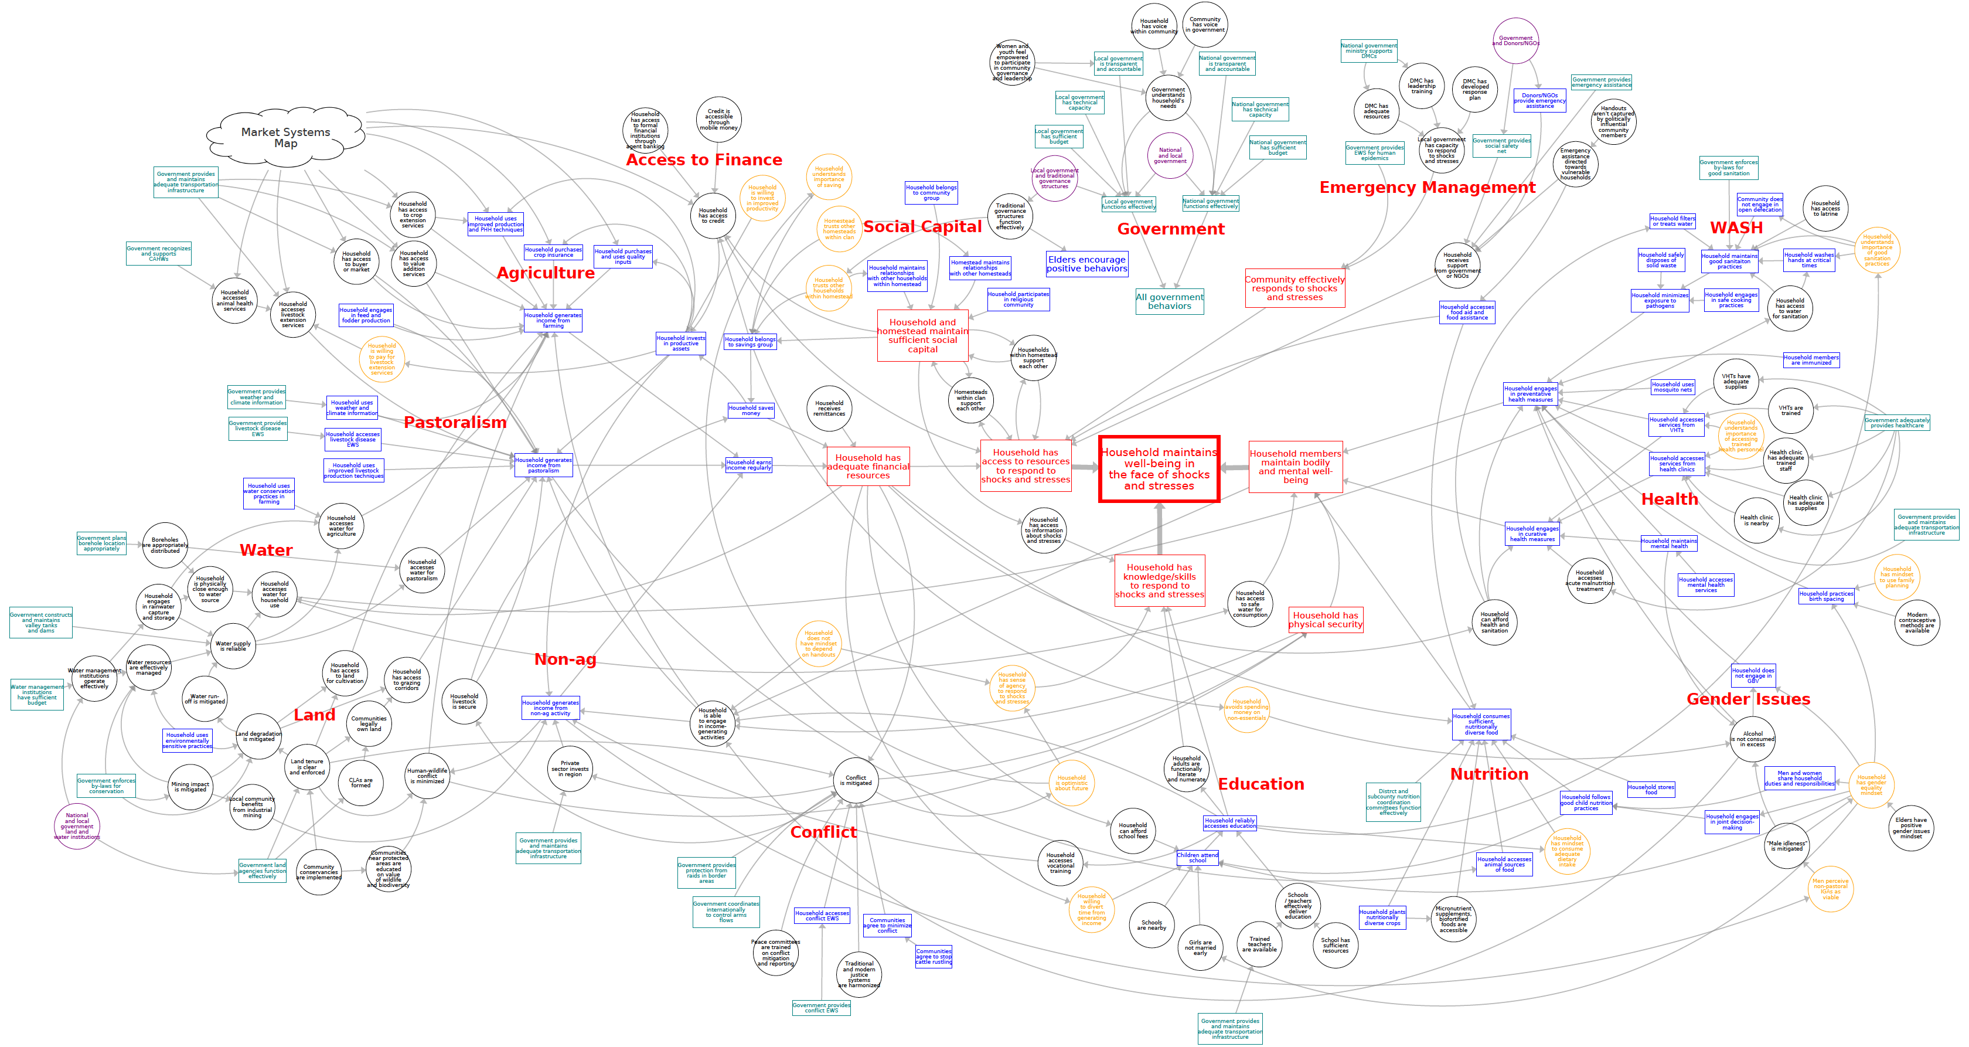
Karamoja Household Resilience Map: Key concepts
Market Systems
Access to Finance
Emergency Management
Social Capital
Government
WASH
Agriculture
Influences whole system
Enables community response
Pastoralism
Income Generation
Resilience
Health
Enables income generation
Water
Enables income generation
Non-Ag
Land
Gender
Education
Nutrition
Conflict
Enabling Environment
Human Capital

Slide 33


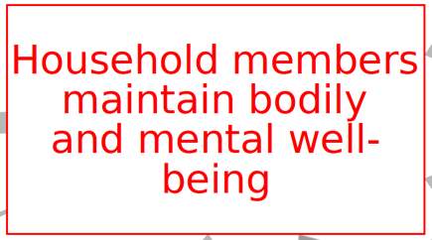
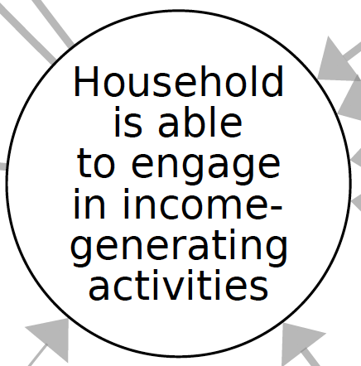
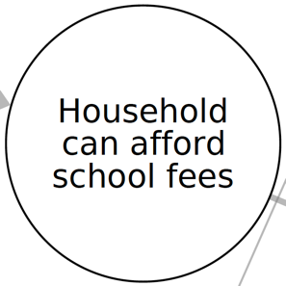

Pathway: Education
Well-being and education enable income
Education enables well-being through WASH
Income enables education
Other enablers / barriers?

Slide 34
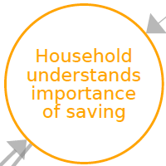
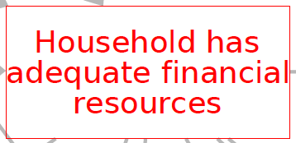

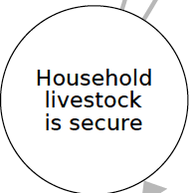
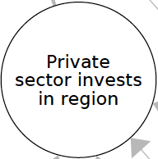
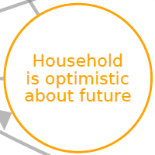
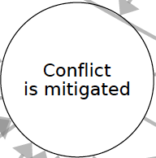
Pathway: Conflict
Peace enables income through optimism and saving
Peace enables income through secure livestock
Peace enables income through private sector investment
Income negates need for conflict
Peace enables income through physical security
Other enablers / barriers?

Slide 35
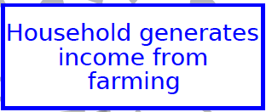


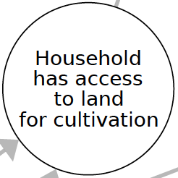
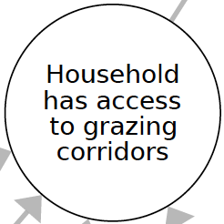
Pathway: Land
Land access enables income
Enablers / barriers?

Slide 36
Karamoja Ag Market System Map: Key flows
Financial
Material
Information

Slide 37
Karamoja Ag Market System Map: Key subsystems
Inputs Distribution:
Agrodealer
Farmer Market Practices:
Farmer
Aggregation:
Farmer group
Commodity Distribution:
Trader

Slide 38
Activities
Module: Pathways

Slide 39
Facilitator Instructions
Purpose of this module:
This module introduces the idea of a pathway, explains how to locate one on an existing map, and provides an exercise to practise drawing a new pathway.
Guidelines:
Make sure participants have access to map elements as a reference before they start to draw a pathway.
Sub-modules in this module:
What is a pathway?
Finding a pathway on an existing map
Brief pathway example
Drawing a pathway

Slide 40
Activities
Module: Pathways
Sub-module: What is a pathway?

Slide 41
Facilitator Instructions
Purpose of this submodule:
Introduce the concept of a pathway that moves from an intervention to an outcome.
Guidelines:
None
Slides in this module:
Pathway introduction
Four example pathways

Slide 42
Pathways
Pathways are a set of
connected map elements that:
  Lead to an outcome
  From an intervention or leverage point
  Pathways can:
    Be linear
    Include branches
    Even be loops
In the previous session we drew a pathway from an intervention to an outcome – replicating a part of one of your activity’s result chains.
Notes:
Point of a pathway is to give you handle that you can use to understand the map – they are a set of elements working in concert toward the same goal

Slide 43
Example: Financial and Business Services Pathways
In the financial and business services subsystem, the colors highlight examples of pathways:
  Insurance
  Affordability Pathway
  Access Pathway
  Loan Requirements Pathway
  Informal Financing Pathway
  Information Pathway
  Demand Pathway
  Supply Pathway
  Business Practices
Pathways are labeled for easy reference and to describe their influence on the system
Notes:
Mention that pathways can be linear, branching, and loops as a transition to the next slide

Slide 44
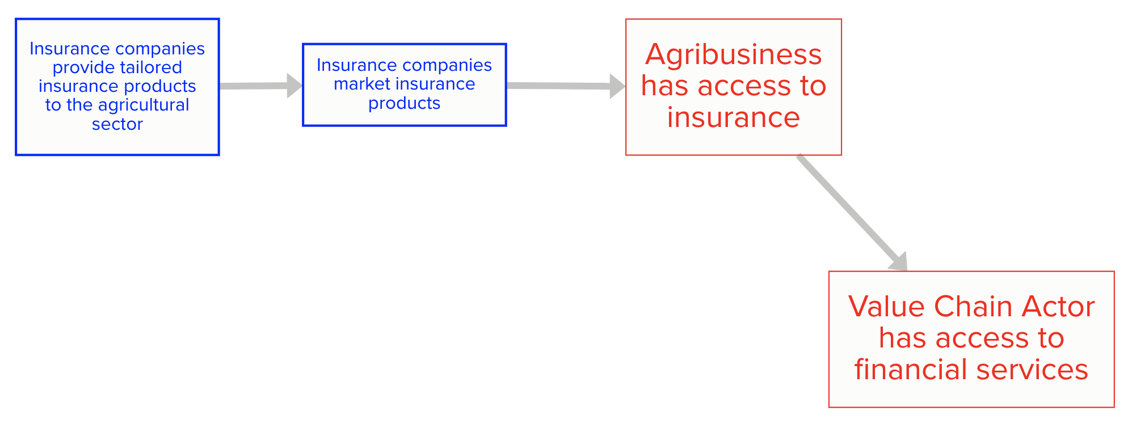
Example: Insurance Pathway
The Insurance pathway is an example of
a linear pathway
Linear pathways:
Move in a single direction
Each element enables the next until the pathway reaches the outcome
Notes:
Find it in the Financial and Business Services subsystem. It is colored pink.
Ex: Miller has insurance on their machinery enables them to approach a bank for a loan

Slide 45
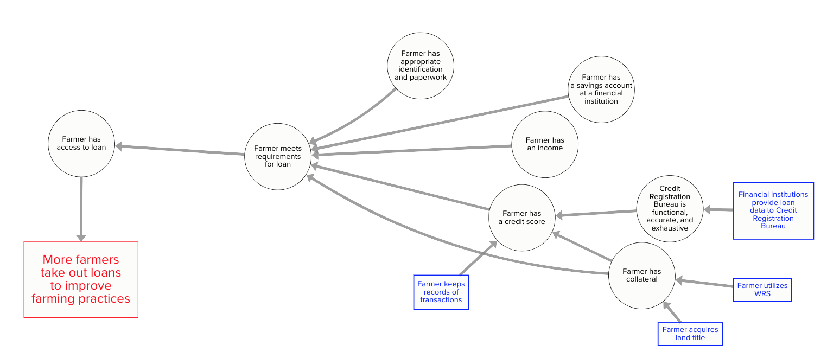
Example: Loan Requirements Pathway
The Loan Requirements Pathway is an example of a branching pathway:
Many elements combine to enable
elements above them on
the pathway
NOTE: It is an “art” to decide which elements to include or leave out
of a pathway
Notes:
Find it on the right hand side of the Financial and Business Services subsystem. It is colored orange.
Art: If you look on the map, there are connected elements that are not highlighted. For example: Farmer gets bank card. Have to decide if something is central to what you are trying to capture in the pathway. There can be more than one right answer.

Slide 46
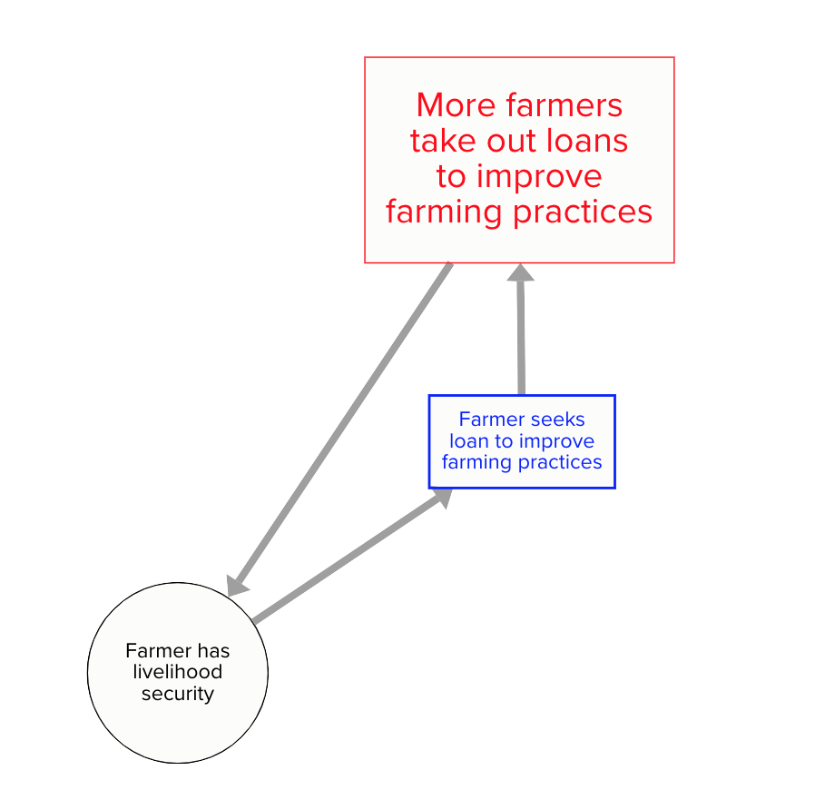
Example: Livelihood Security Loop
The Livelihood Security pathway is an example of a loop pathway:
Circular pathway
Often important in achieving systemic change as small changes can build into larger/more widespread changes as the cycle is repeatedly executed
Can be key pathways to measure
Notes:
Find the Outcome called “More Farmers take out loans to improve farming practices” in the middle of the Financial and Business Services subsystem.
We did not color this one. You can find several on the map.
In system dynamics we call this a reinforcing loop. As you keep traveling on this pathway, the elements are strengthened.

Slide 47
Activities
Module: Pathways
Sub-module: Brief pathway example

Slide 48
Facilitator Instructions
Purpose of this submodule:
Walk participants through an example pathway on the map.
Guidelines:
This sub-module directly leads to activities asking participants to identify an existing pathway and then draw a pathway for themselves.
Slides in this module:
Build of a pathway from a Key Outcome asking “what enables this” at each step.

Slide 49
Where’s the pathway?
Key outcome: more farmers take out loans to improve farming practices
Pathway focus: farmer has a mobile phone

Slide 50
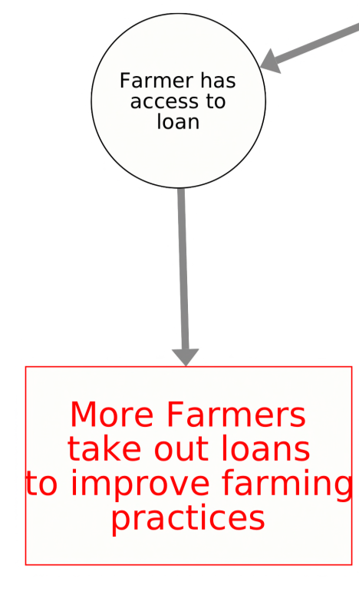
Where’s the pathway?
Key outcome: more farmers take out loans to improve farming practices
Pathway focus: farmer has a mobile phone
What enables this?

Slide 51
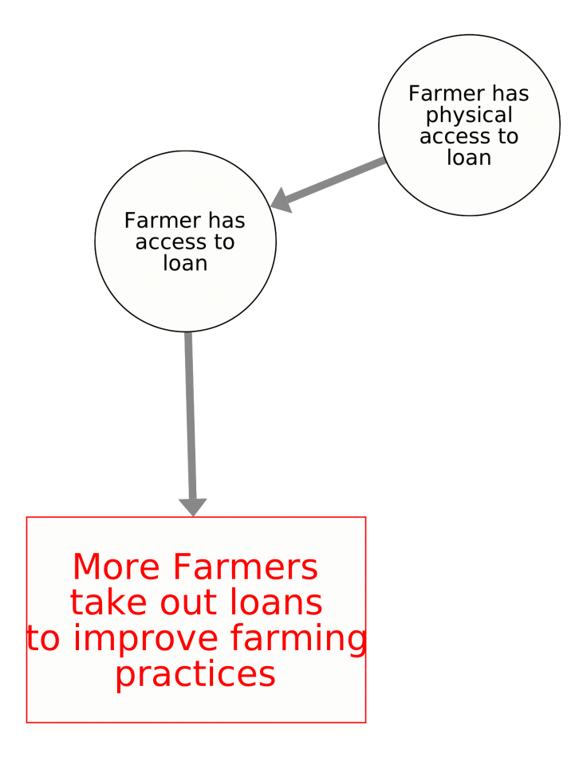
Where’s the pathway?
Key outcome: more farmers take out loans to improve farming practices
Pathway focus: farmer has a mobile phone
What enables this?

Slide 52
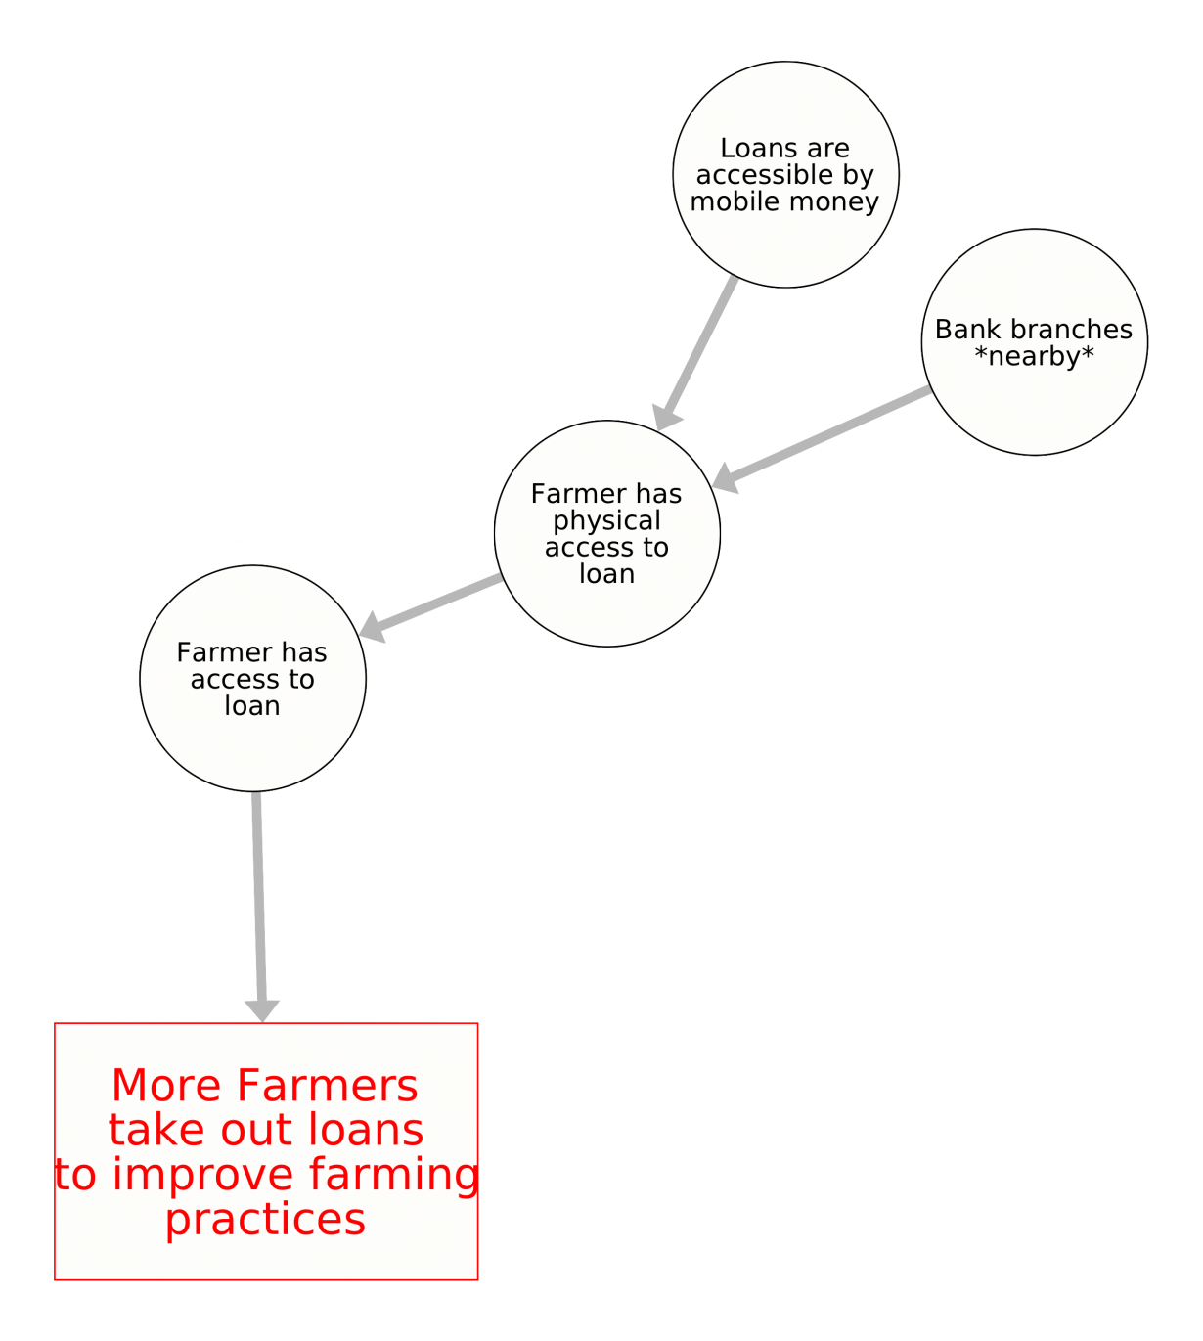
Where’s the pathway?
Key outcome: more farmers take out loans to improve farming practices
Pathway focus: farmer has a mobile phone
What enables this?

Slide 53
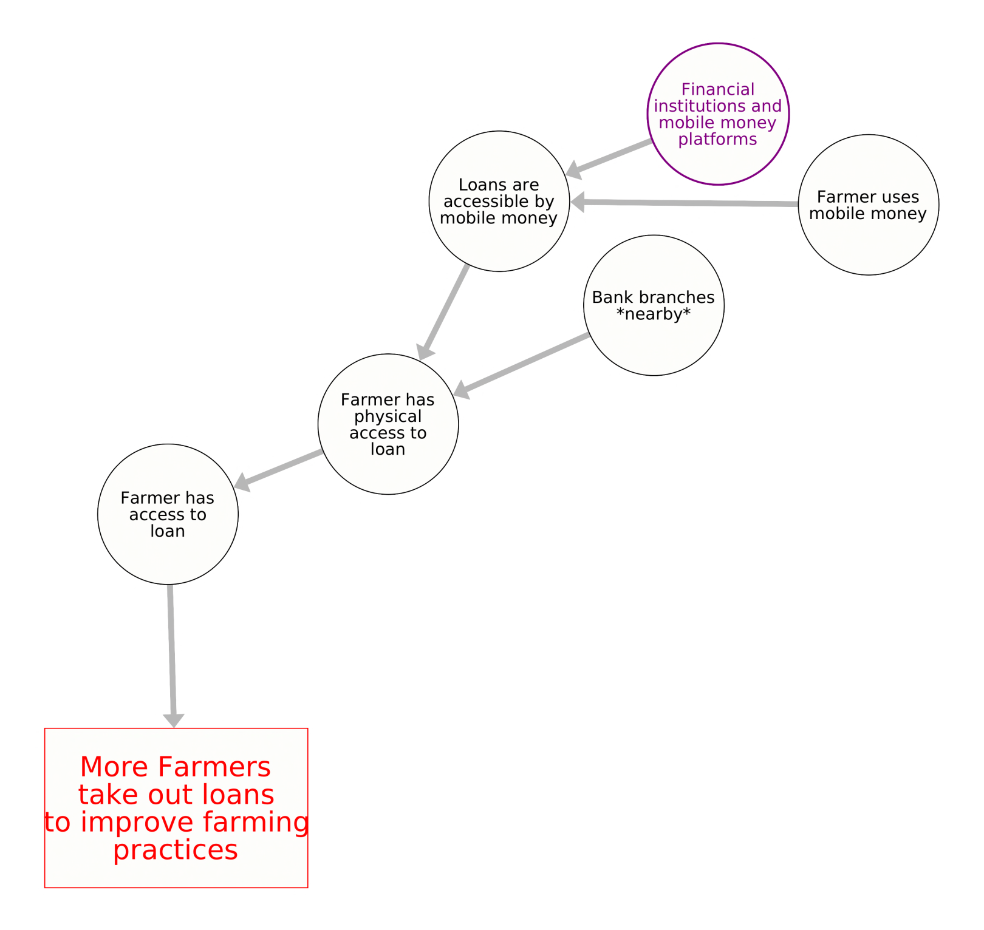
Where’s the pathway?
Key outcome: more farmers take out loans to improve farming practices
Pathway focus: farmer has a mobile phone
What enables this?

Slide 54
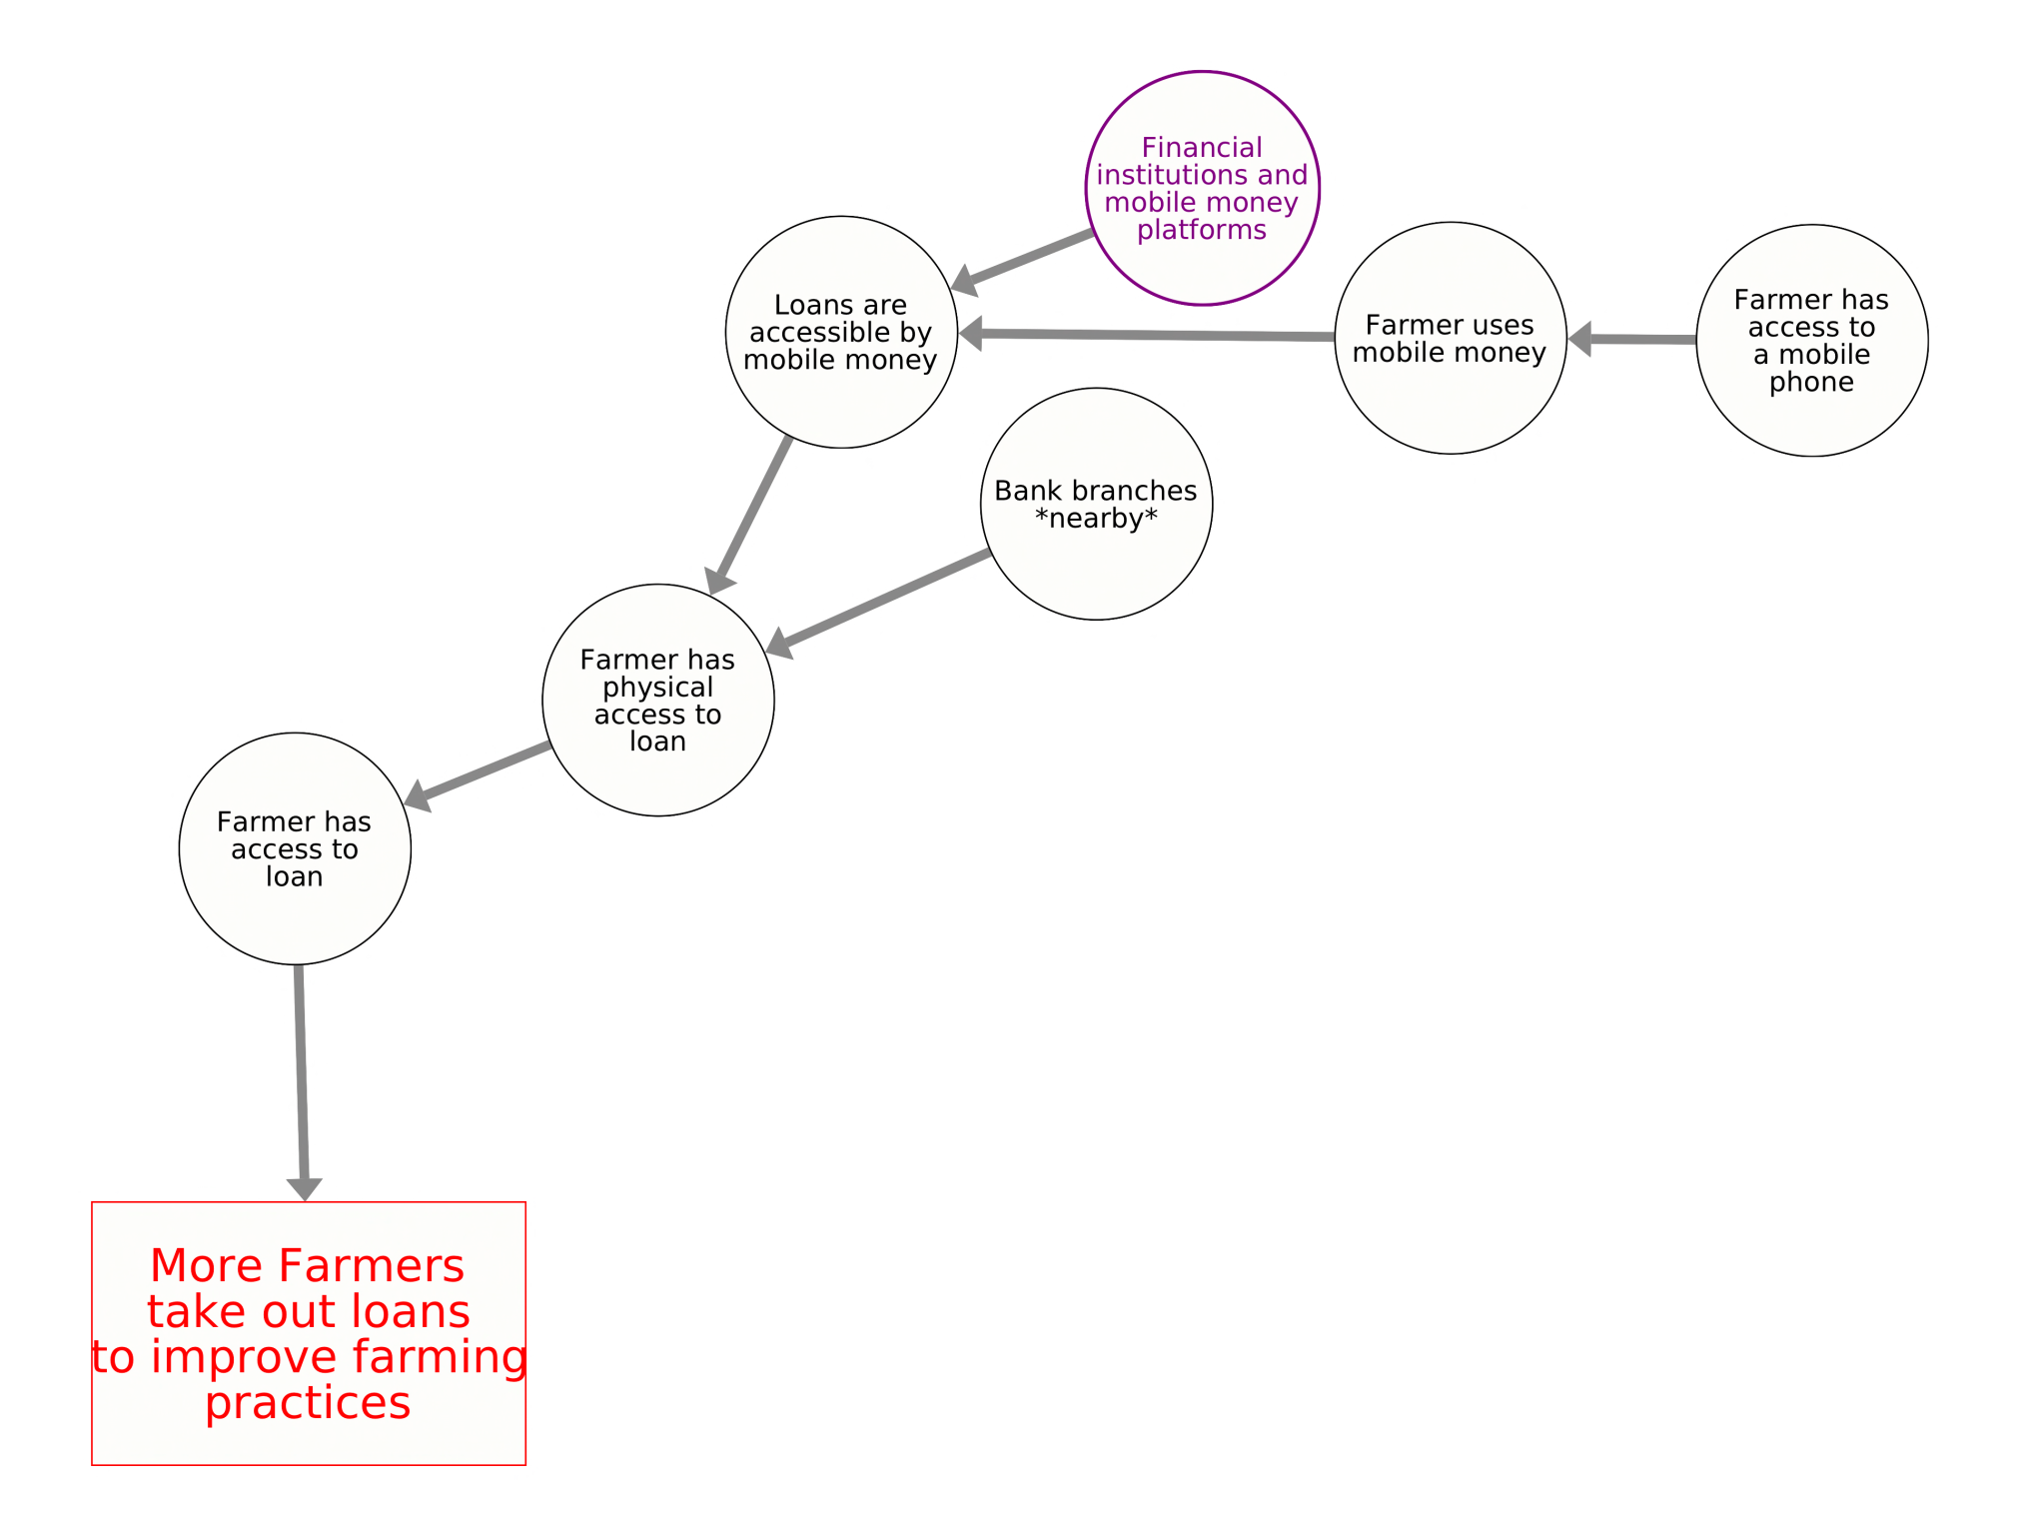
Where’s the pathway?
Key outcome: more farmers take out loans to improve farming practices
Pathway focus: farmer has a mobile phone

Slide 55
Activities
Module: Pathways
Sub-module: Finding a pathway on an existing map

Slide 56
Facilitator Instructions
Purpose of this submodule:
Have participants identify a pathway on a system map.
Guidelines:
None
Slides in this module:
How to identify a pathway
Activity instructions
Activity handout

Slide 57
Identifying Pathways
Focus on a key outcome
Trace back through the map to
a small, related set of
important interventions or
leverage points that enable
the outcome
Does the pathway…
  Capture elements that are well
  connected to other elements (lots of arrows)?
  Need to include other interventions
  and additional branches

Slide 58
Activity: Identifying Pathways
Find your intervention
Find your outcome
Highlight your pathway on the map
  Start at your intervention and trace how it connects to your outcome (linear, branching, or circular)
  If modifications are needed, make edits using the thin marker (no need to add detail)
  Highlight the pathway on the map (on the top layer wizard wall) – use the region color
  Name your pathway (include your activity name)
Document your pathway
  Document the pathway on the “Activity Pathways” worksheet
Repeat for each intervention from your Activity
  Name each pathway, and highlight them in your activity’s color

Slide 59
ACTIVITY: Identifying Pathways – Geographic Regions
red
blue
green
orange or brown
purple
Don’t forget to name your pathway:
Ex: Activity-Name Pathway-Name
Karamoja
Feed the Future ZOI
National Parks / Conservancy Areas
National-level
Other
When highlighting a pathway, use the color of the region the intervention is operating
Notes:
Because we are going to have so many of these pathways, we thought it would be to differentiate between the geographic regions they operate in.

Slide 60
Activities
Module: Pathways
Sub-module: Drawing a pathway

Slide 61
Facilitator Instructions
Purpose of this submodule:
Activity where participants draw a pathway.
Guidelines:
Ensure participants have a copy of the map element guide.
Slides in this module:

Slide 62
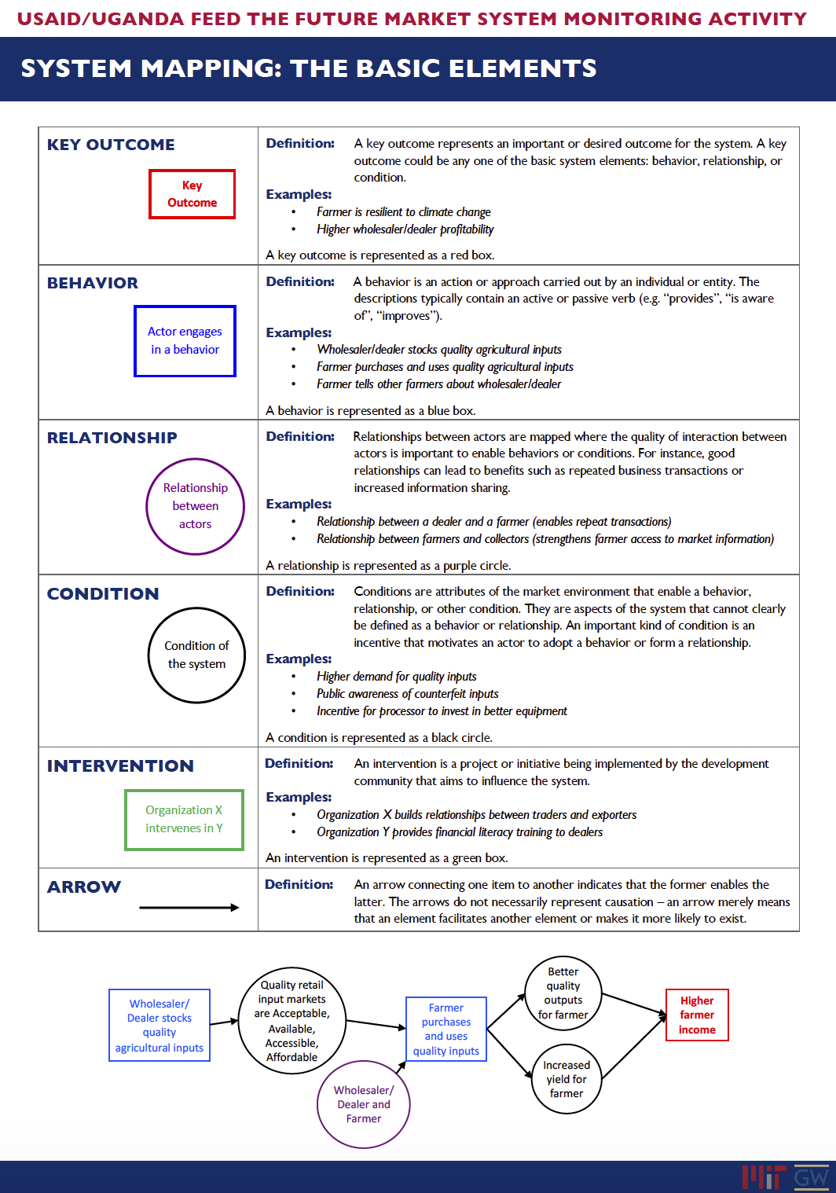
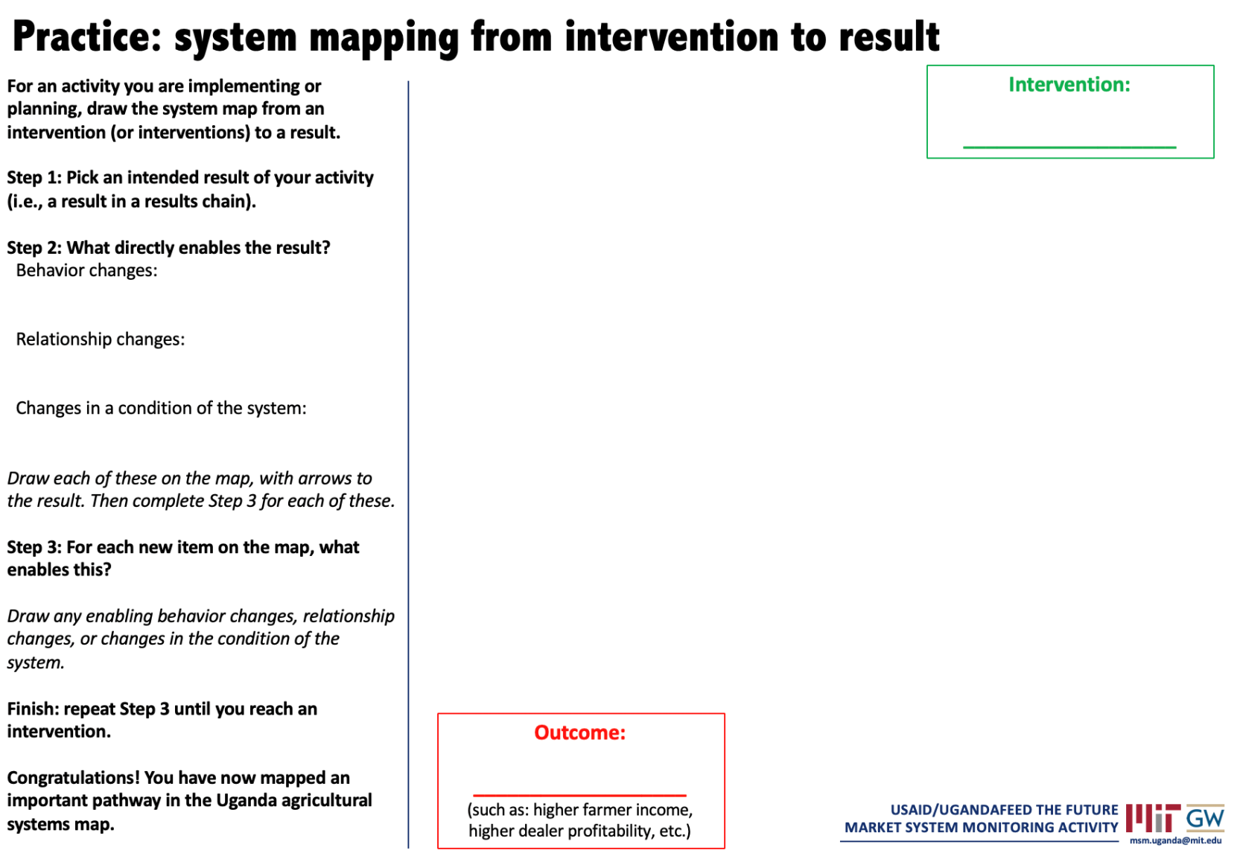
Practice exercise materials

Slide 63
Practice: system mapping from intervention to result
For an activity you are implementing or planning, draw the system map from an intervention (or interventions) to a result.
Step 1: Pick an intended result of your activity (i.e., a result in a results chain).
Step 2: What directly enables the result?
Behavior changes:
Relationship changes:
Changes in a condition of the system:
Draw each of these on the map, with arrows to the result. Then complete Step 3 for each of these.
Step 3: For each new item on the map, what enables this?
Draw any enabling behavior changes, relationship changes, or changes in the condition of the system.
Finish: repeat Step 3 until you reach an intervention.
Congratulations! You have now mapped an important pathway in the Uganda agricultural systems map.
Intervention:
___________________
Outcome:
___________________
(such as: higher farmer income, higher dealer profitability, etc.)

Slide 64
Activities
Module: Find yourself on the map

Slide 65
Facilitator Instructions
Purpose of this module:
Locate where your organization operates in the system. Understand how your work interacts with the system as a whole.
Guidelines:
Look for pathways and key outcomes that multiple organizations are trying to influence. This module naturally leads into to the “Adding interventions” module.
Slides in this module:
Activity to locate and mark where your organization works in the system
“Taking Stock” handout

Slide 66
Activity: Find your work
Tour the market systems map
Find pathways where your work intersects with the market system
Complete ”Taking Stock” Activity
Discuss interactions with donors, other organizations, and the market system

Slide 67
Taking Stock: Behaviors, Relationships, and Conditions
Name
Organization
What behavior changes, relationships, and conditions
are influenced by my organization?
Behavior Changes
Relationships
Conditions

Slide 68
Activities
Module: Adding data

Slide 69
Facilitator Instructions
Purpose of this module:
Introduce how to add data to the map to enable measurement of the system.
Guidelines:
Participants should be familiar with the concepts behind a system map before introducing this topic.
Sub-modules in this module:
Introduction to Measurement
Example with Data
Pick and measure indicators

Slide 70
Activities
Module: Adding data
Sub-module: Introduction to Measurement

Slide 71
Facilitator Instructions
Purpose of this module:
Introduce how to measure change using a system map.
Guidelines:
None.
Slides in this module:
Introduction
What parts to measure
Interpreting data
Diagnosing problems and showing influence
Implementation

Slide 72
Measuring change is crucial but challenging
Which parts of a vast, complex system to measure?
  Map the system and find the pathways that drive change
  Measure key indicators along these pathways
How to interpret data to understand system health?
  Assess system “health” on the map: on pathways, subsystems, system
  Diagnose problems, identify positive changes and spillovers
  Are changes systemic? Check for concerted, expansive change
Warning: this is complex!
Notes:
This is complex. Today is just a high-level intro: don’t expect to get every detail. We would be happy to talk further with anyone who wants to understand or use this.

Slide 73



















Which parts to measure? Monitoring a single intervention
Suppose we have a single intervention
  Goal: enable farmers to access loans
  Pathway: train farmers to meet loan requirements
What should we measure?
  “Traditional” approach: input and outcome
    Farmers trained (input)
    Farmers who took out loans (outcome)
  What if many were trained yet few took loans?
  Need diagnostic indicators to diagnose the problem
    Early diagnostic indicators check for changes that happen faster than loan access
    Off-pathway diagnostic indicators look for barriers on related pathways
O
E
E
Farmers trained
O
Notes:
Pathway: our interventions are: train farmers to keep records of transactions, get documents, etc.
Early diagnostic indicators:
- Farmers keep records
- Farmers meet requirements
Off-pathway diagnostic indicators
- Farmer has physical access to loan
- Farmer seeks loan (i.e. willing to take on risk, trusts institution, understands value)

Slide 74
Which parts to measure? Monitoring a portfolio at the system level
Suppose we have a portfolio of interventions
  Goal: change agricultural market system to enable higher farmer income
  Pathways: finance, inputs, market, regulatory
What should we measure?
  Key outcome indicators along each major pathway
  Diagnostic indicators to find problems and successes
  Early diagnostic indicators since outcome changes are slow
  Off-pathway diagnostic indicators to check for potential barriers or positive spillovers
Access to finance
Farmers take loans to improve farming
Access to quality inputs
Market for quality products
Mfr/Ipr stocks quality inputs
Farmers use quality inputs
Trader profitability [via farmer support]
Higher farmer incomes
Wholesaler/dealer stocks quality inputs
Mfr/Ipr participates in anti-counterfeit
Free
inputs less
available
Government enforces regulations effectively
Regulatory environment
* From AAER framework: Springfield Centre, “Adopt-Adapt-Expand-Respond” March 2014.
Notes:
Mention that we have a defined system we’re trying to affect
Diagnostic across pathways: Are the input availability and access to finance actually enabling farmers to use quality inputs?
Early: are manufacturers actually participating in anti-counterfeit?
Off-pathway: Are free inputs blocking these pathways?

Slide 75
Measuring change is crucial but challenging
Which parts of a vast, complex system to measure?
  Map the system and find the pathways that drive change
  Measure key indicators along these pathways
How to interpret data to understand system health?
  Assess system “health” on the map: on pathways, subsystems, system
  Diagnose problems, identify positive changes and spillovers
  Are changes systemic? Check for concerted, expansive change
Notes:
This is complex. Today is just a high-level intro: don’t expect to get every detail. We would be happy to talk further with anyone who wants to understand or use this.

Slide 76
Measuring and interpreting data
Example: not based on real data/measurement!
Most map elements describe a desired behavior or state of the system, such as “dealers stock quality inputs” or “government enforces regulations effectively”
Measure the adoption and expansion of that behavior/state*
Pathway, subsystem, and system “health” can be read at a glance
Expanded to most others
Adopted by all directly targeted participants
* From AAER framework: Springfield Centre, “Adopt-Adapt-Expand-Respond” March 2014.
Notes:
PATHWAY
Loan requirements pathway: early diagnostics are green, working, but outcome is yellow
SUBSYSTEM
Access pathway: yellow, some farmers have access, might be a barrier
Demand pathway: red. Likely a barrier to achieving outcome of farmers accessing loans
SYSTEM
Finance: yellow, adopted a little beyond pilot participants
Inputs and Regulatory: orange, just adopted by some pilot participants
Market for outputs: green, working well.
In this example… our desired behaviors have been adopted only by pilot participants.
NOTE: Why don’t we have data on farmers taking out loans? We have: 11.1% of households surveyed say financial institutions offered them loans CGAP 2015 . Is this non enough for farmers taking them out? Why would CGAP have this info and not whether farmers took out loans?

Slide 77
Diagnosing problems and showing influence
Zoom in to diagnose problems, identify sources of success
Zoom out to see spillover and influence on system
System health problems can be diagnosed
  Identify problem areas on system (or subsystem) map
  Zoom in on pathways leading to problem, check diagnostic indicators
Success’s influence on entire system can be shown
  From pathway’s success, show spillover on other pathways in subsystem
  Zoom out to system map, show how subsystem’s success influences rest of system

Slide 78
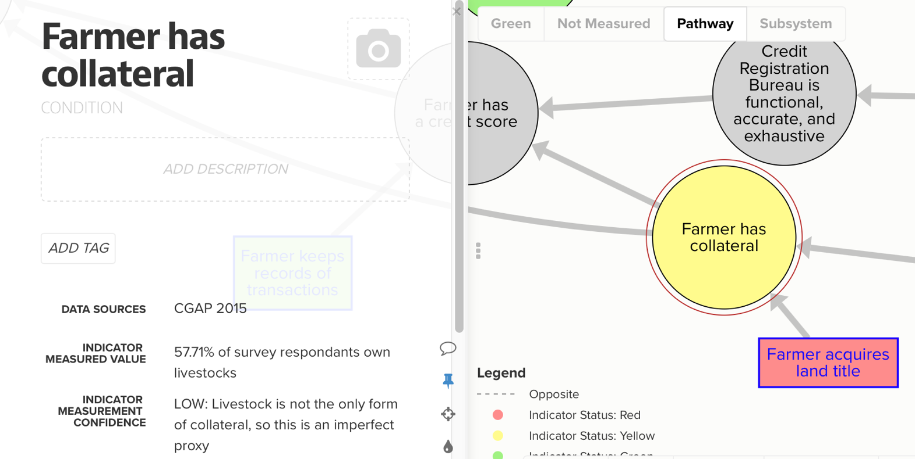
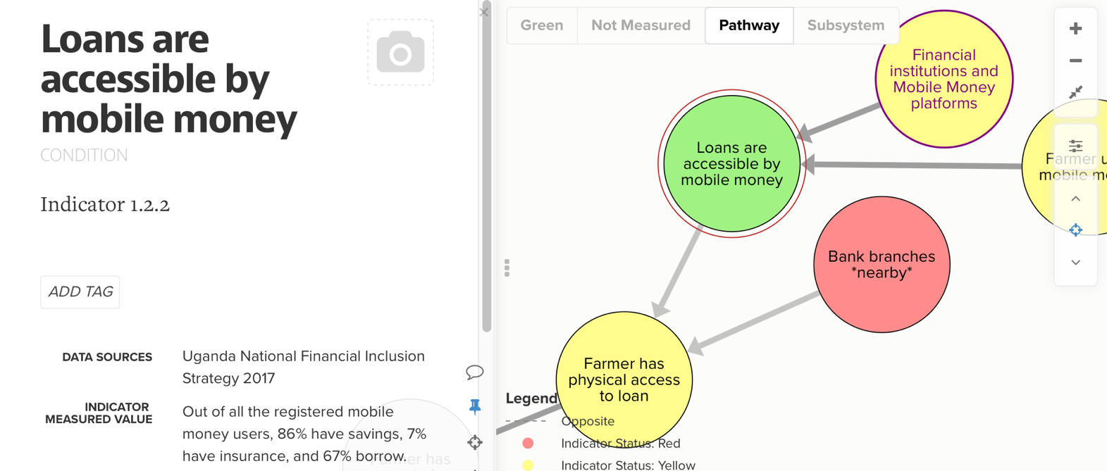
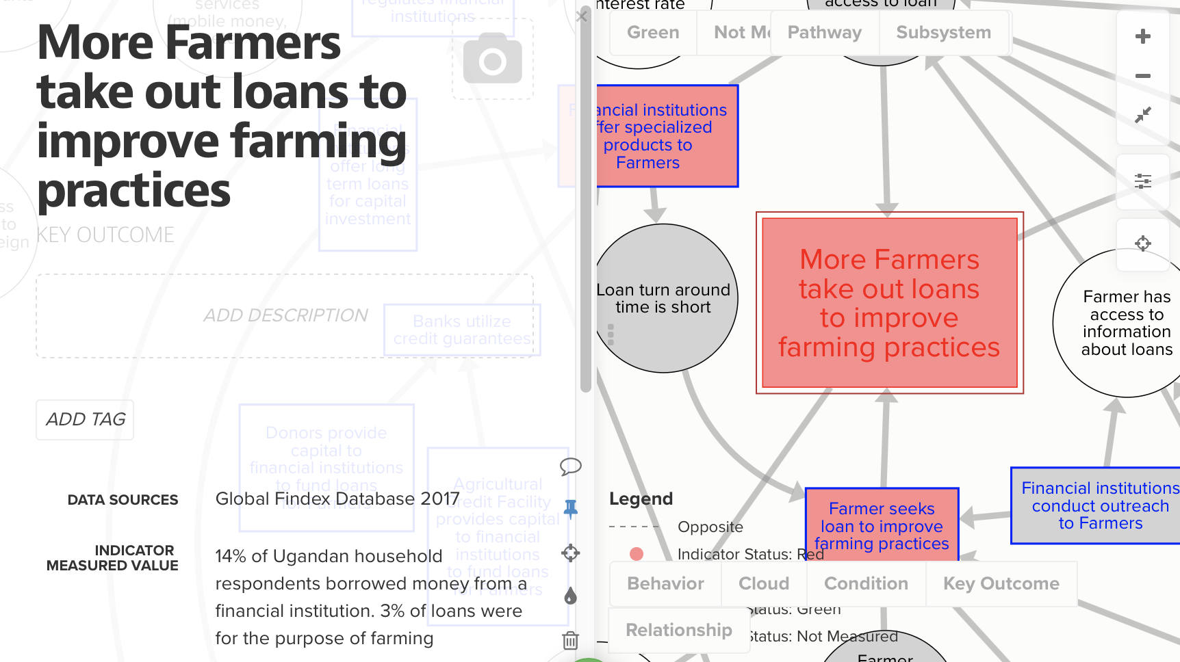
Implementation
Lots of data needed, so use existing sources, but consider:
  Timeliness: how old? Before or after recent changes?
  Scope: nationally or regionally representative?
  Relevance: does the question measure all or part of (or a proxy for) the adoption behavior?
Periodically revisit map and indicators, adapt approaches
  At least once per year, maybe more: depends on pace of change, ability to change course of intervention/activities
  Reserve time for interpretation, learning (e.g. workshop)
  May need to measure beyond end of project, to understand slow-moving outcomes, spillovers
Notes:
Point out that the banks have data on farmers taking out loans, might be another way to get it

Slide 79
Activities
Module: Adding data
Sub-module: Example with data

Slide 80
Facilitator Instructions
Purpose of this module:
Provide a short example adding data to several related “access to finance” pathways.
Guidelines:
None.
Slides in this module:
Example data
Access pathway
Loan Requirements pathway
Demand pathway
Subsystem: Access to Finance

Slide 81
Example with measured data: access to finance
Sources
Access and Use of Credit in Uganda - EPRC
Access to and Investment of Formal Micro Credit by Smallholder Farmers - 2011
Ag Finance in Uganda - The Way Forward 2004
Bank Efficiency, Ownership and Market Structure - WPS 2006
Barriers to Bank Access and Use Around the World - WPS 2006
Business Environment and Growth Potential of Micro and Small Manufacturing Enterprises in Uganda - 2011
Can Mobile Money Help Firms Mitigate the Problem of Access to Finance in Eastern Sub-Saharan Africa - 2018
Catalyzing Smallholder Ag Finance - 2012
Credit Demand and Credit Rationing in the Informal Financing Sector in Uganda - 2005
Factors Influencing Smallholder Farmer Access to Credit - 2013
Financial Access and Exclusion in Kenya and Uganda - 2011
Financing Medicine's Last Mile in Uganda - MIT 2015
FinScope Topline Findings Report - FSDU 2018
Health Financing Strategy - ROU 2016
How to Make Ag Finance Work - 2014
Increasing Ag Sector Financing - 2010
Inflection Point - Dalberg 2016
Social Capital and Access to Credit Evidence from Uganda - 2016
Strategic Plan 2015 to 2020 - FSDU 2015
Sub-Saharan Africa Banking Review - EY 2014
The Global Findex Database - World Bank 2017
The Power of Mapping Financial Services Data - 2013
The Profit Orientation of Microfinance and Effective Interest Rates - 2012
Uganda Ag Finance Yearbook - BOU 2015
Uganda Ag Finance Yearbook 2011
Uganda Economic Update - World Bank 2017
Uganda National Financial Inclusion Strategy 2017 to 2022 - ROU 2017
Why are interest spreads so high in Uganda? - 2008
CGAP Smallholder Household Survey_UGA 2015_Household_Mar18
CGAP Smallholder Household Survey_UGA 2015_Single_Mar18
cgap_smallholder_household_survey_uga_2015_multiple_feb_16
Global Findex Database
Final FS Uganda 2018 current dataset
Measured three finance pathways
  Access
  Loan Requirements
  Demand
Used existing data, publicly available (mostly)
  Sought data for all elements, to identify “holes” in data
Rated status according to scale (approx.)
Expanded to most others
Adopted by all targeted participants

Slide 82
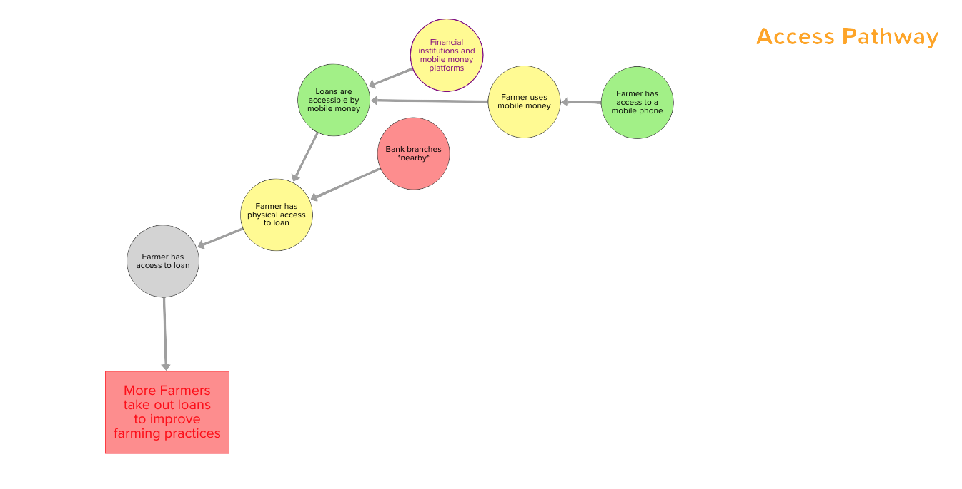
Example with measured data: access
Notes:
Starting at the right, loans seems to be accessible via mobile money to many but not all people. This means that, despite bank branches not being near most rural farmers, many still have physical access to loans. But we don’t know whether this is translating into access to loans (though it’s certainly not translating into actual, provided loans).

Slide 83
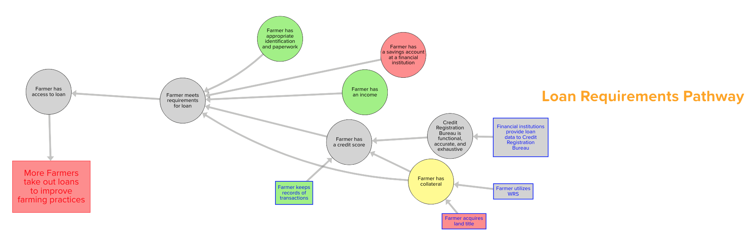
Example with measured data: loan requirements
Notes:
Here, the story is less clear. While most farmers have identification and income and keep records of transactions, few have land titles nor savings accounts. Some have other forms of collateral (we used livestock here). But there’s a lot of grey on this pathway, meaning we don’t really know what’s happening in the end: whether this green enables farmers to meet requirements, or the red and yellow are blocking that from happening.

Slide 84
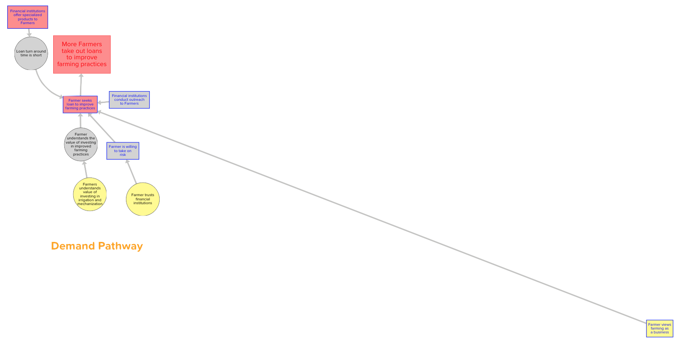
Example with measured data: demand
Notes:
Now, for demand, the story does not look very good. Few financial institutions are tailoring products to farmers, and while some farmers understand value of investment and trust financial institutions, they don’t seem to be seeking loans. And the grey means we can’t really see why. So this is a place where we’d want to investigate.
IN THESE THREE PATHWAYS, this is where the problem lies. Interest rates are also a problem, but we didn’t look at that pathway yet.

Slide 85
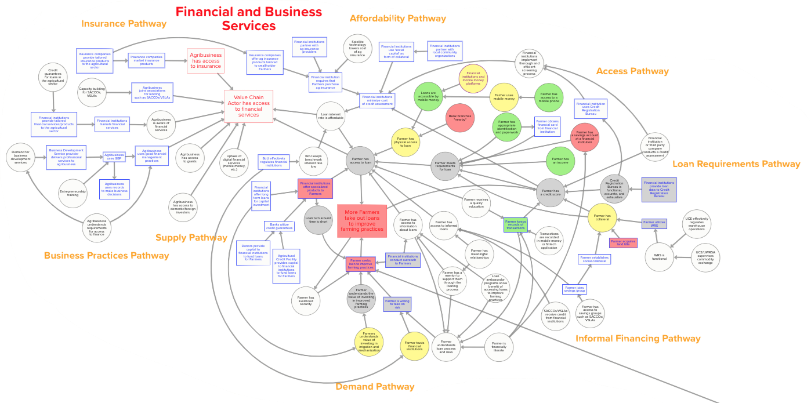
Example with measured data: access to finance
Notes:
So looking at the entire subsystem, access is OK, but we don’t know if farmers can meet loan requirements, and it looks like the demand for loans just isn’t there. ALSO, there are other pathways we haven’t looked at today, like high interest rates might also be a barrier.
This shows how we need to solve all these three problems at once in order to make progress on farmers taking out loans. It also shows how not knowing certain things about the system makes it hard to diagnose problems. Finance is pretty well studied, but even here there are holes in our knowledge due to lack of data.

Slide 86
Activities
Module: Adding data
Sub-module: Pick and measure indicators

Slide 87
Facilitator Instructions
Purpose of this module:
Introduce how to identify indicators to measure and determine system health.
Guidelines:
None.
Slides in this module:
Activity: Pick indicators
Systemic change

Slide 88
Activity: Pick indicators and “measure” them, assess subsystem health
Select a subsystem and about 1-3 activity pathways within it
Select indicators that would help you monitor the “health” of this subsystem
  Place a purple post-it by each map element you choose to measure
    Key outcomes
    Diagnostic indicators, including early and off-pathway
“Measure” your indicators
  Replace your post-its with colored post-its (red, yellow, green) to indicate extent of adoption, according to your team’s knowledge. If you have insufficient knowledge, leave the purple post-it in place to indicate “unknown”
Assess the subsystem health
  Health: What is the “health” of each pathway? of the subsystem?
  Diagnose problems: What are the barriers to change?
  Identify success: Have the healthy pathways influenced the rest of the subsystem and system? How?
  Measurement gaps: Are there important gaps in data availability?
Expanded to most others
Adopted by all directly targeted participants
Limited adoption
Moderate adoption
Widespread expansion
Unknown

Slide 89
“Extra credit”: systemic change
Expanded to most others
But is there systemic change?
Still no clear definition of systemic change
Our “working” definition: change is systemic if it is:
  Expansive: health status demonstrates “crowding in”, or widespread adoption beyond directly targeted participants…
  Concerted: … in all key outcomes throughout the system
Requires defining the system, its key pathways and outcomes, and adoption/expansion targets
Adopted by all pilot participants
Systemic
NOT systemic
* From AAER framework: Springfield Centre, “Adopt-Adapt-Expand-Respond” March 2014.

Slide 90
Activities
Module: Adding interventions

Slide 91
Facilitator Instructions
Purpose of this module:
Introduce how to add interventions to a system map.
Guidelines:
This activity works well after having completed the “Find yourself on the Map” activity. Approach this using work your activity is already doing by referencing workplans and existing logical frameworks.
Slides in this module:
Adding interventions from workplan example
Activity: Mapping activities and interventions

Slide 92
System Map: Adding interventions from workplans
Interventions are added
as a green box
From workplan
(greyed out = not relevant for map)

Slide 93
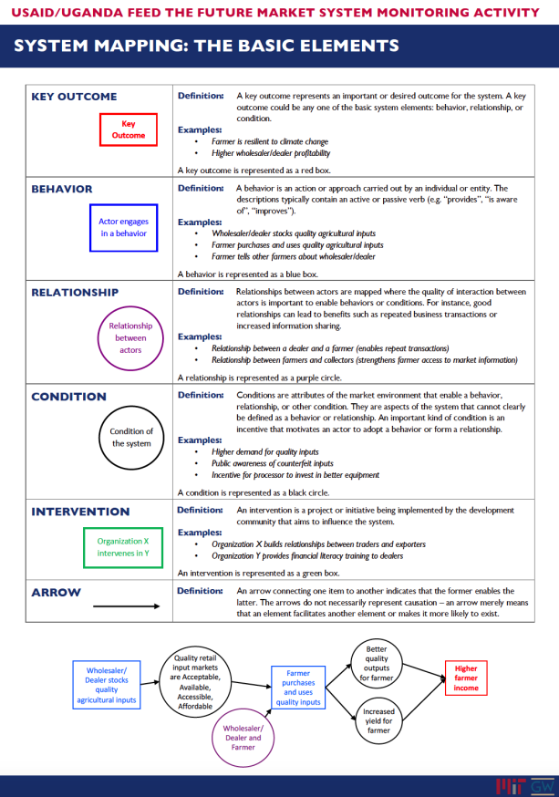
Mapping activities & interventions
“Put your activities on the map”
  Goal: place your existing and planned interventions on the map, using GREEN dry erase marker
    If necessary: add elements using BLACK dry erase marker (or BLUE for behavior change)
  Note: the goal is not map correction or validation, though we welcome input on a separate sheet
    correct big issues
    add missing elements
  Time: you have until HH:mm

Slide 94
Activities
Module: Barriers and gaps

Slide 95
Facilitator Instructions
Purpose of this module:
Introduce the ideas of barriers and gaps and how to identify them on a system map
Guidelines:
Start with an existing map
Submodules in this module:
Identifying barriers
Identifying gaps

Slide 96
Activities
Module: Barriers and gaps
Sub-module: Identifying barriers

Slide 97
Facilitator Instructions
Purpose of this module:
Guidelines:
Slides in this module:
Guidance on identifying barriers
Example
Exercise

Slide 98
Guidance on identifying barriers
What are we looking for?
  Specific elements in the system that are key barriers to progress for USAID interventions
  What is keeping your Activity from creating the intended changes to the system?
Keep in mind:
  The barriers may be on other pathways, not on your immediate “results chain”
  The barrier may not be something USAID can address
  Think about political or behavioral barriers as well as physical ones (lack of infrastructure or supplies)

Slide 99
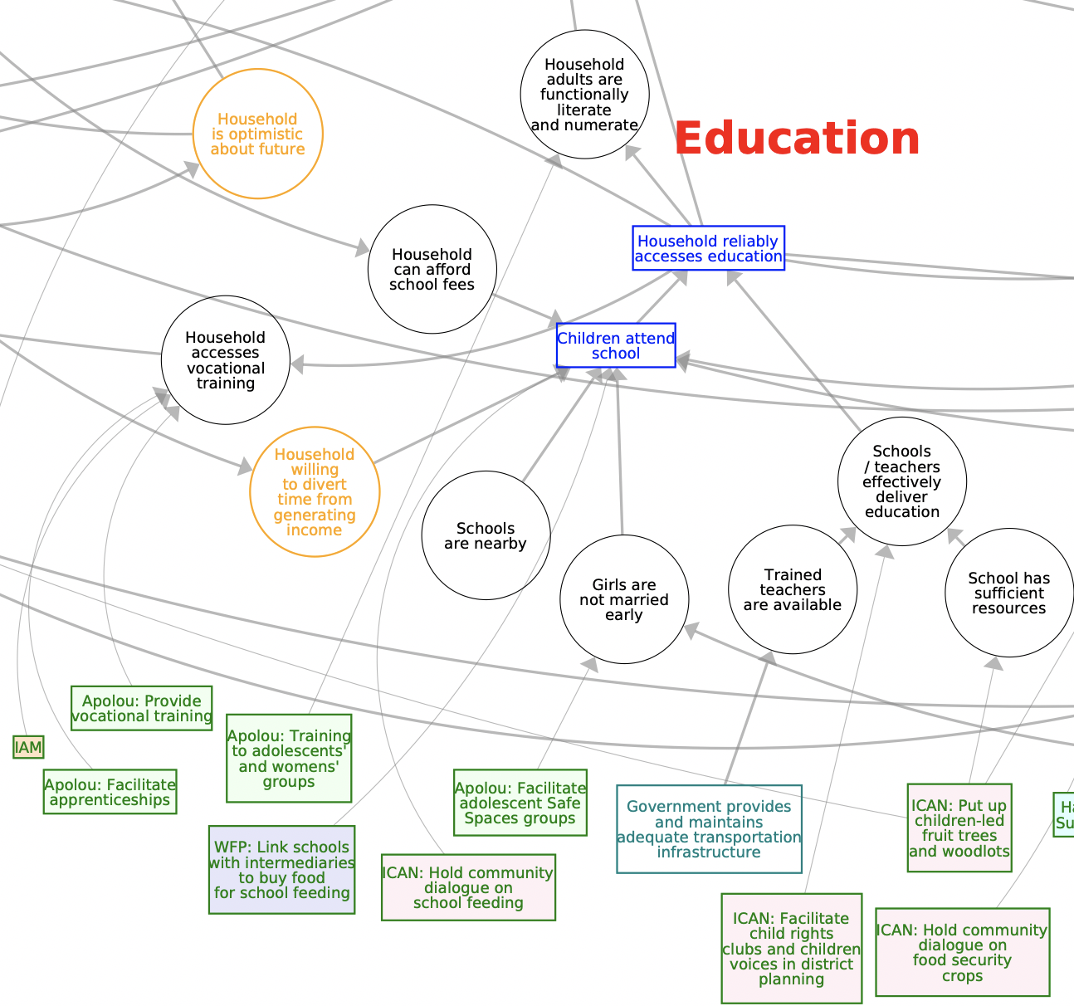

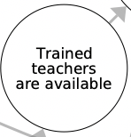
Identifying Barriers: Example
Not very specific, too long-term.
Not a barrier.
More specific, able to be targeted more directly with interventions.
Potential barrier.

Slide 100
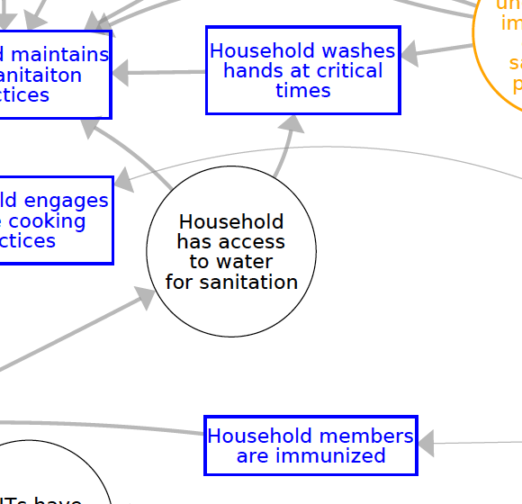
Table Exercise: Identifying barriers
Aim: Identify and document 10 barriers
1. Circle the element in red
2. Write on the worksheet:
Why is this a barrier?

Slide 101
Activities
Module: Barriers and gaps
Sub-module: Identifying gaps

Slide 102
Facilitator Instructions
Purpose of this module:
Introduce how to identify gaps and assign
Guidelines:
Start with an existing map. This module introduces the concept of coloring a gap based on who can change it.
Slides in this module:
Guidance on identifying gaps
Example
Exercise

Slide 103
Guidance on identifying gaps
What are we looking for?
  Specific elements that not being fully addressed by the current portfolio of interventions
  Insufficient coverage, or no coverage at all
Keep in mind:
  The gaps may be something USAID/donors can address, or may be the responsibility of government
  Some gaps are more important than others – focus on the priority gaps for enabling resilience

Slide 104


Identifying Gaps: Example
Already identified as a barrier – is it a gap too?
There are no interventions currently acting on the element, so yes.
If IPs and GoU can both change this, use both colours – green and pink.
There are no interventions currently acting on the element, so this is a gap.
If we think only GoU can change this, highlight only in green.

Slide 105
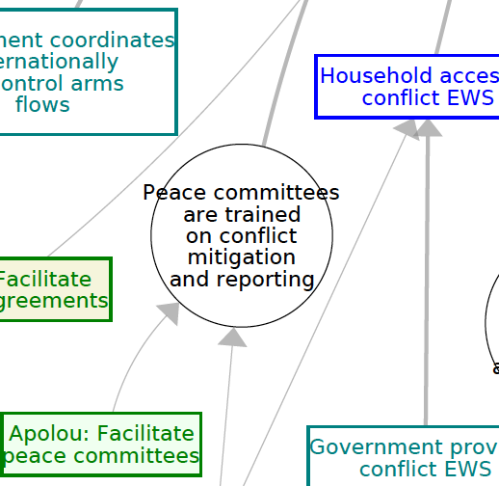
Table Exercise: Identifying gaps
Aim: Identify and document 10 gaps
1. Highlight the element in:
  Pink for IP work
  Pink and green for IP and GoU work
  Green for GoU work
2. Write in the worksheet:
  Why is this a gap?
  How can it be addressed?
  (For IP work) Who could work on this?

Slide 106
Activities
Module: Leverage points

Slide 107
Facilitator Instructions
Purpose of this module:
This modules provides an overview of leverage points and provides activities to find and prioritize them.
Guidelines:
None
Submodules in this module:
Introduction
Identifying and prioritizing

Slide 108
Activities
Module: Leverage Points
Sub-module: Introduction to leverage points

Slide 109
Facilitator Instructions
Purpose of this module:
This module introduces a leverage point and walks through the five step process to identify leverage points
Guidelines:
Need an existing map
Slides in this module:
What is a leverage point
Identifying leverage points (5 step process)
  Map the system
  Select an outcome
  Find important pathways
  Select leverage points
  Prioritize leverage points

Slide 110
What is a leverage point?
An opportunity to intervene in a system in order to change behaviors, relationships, or conditions that will drive changes to a key outcome.
Your current interventions are based around a leverage point that was previously identified, and are working to drive change to an outcome through a particular pathway.
An intervention is the work being done to change a map element at a leverage point.

Slide 111

What is a leverage point?
An intervention acts on a leverage point, which could be
any of the system elements.
Intervention
Capacity building for financial institutions to create farmer profiles
Leverage
Point

Slide 112
Identifying leverage points
Map the system
Find important change pathways
Select leverage points
Select outcome to change
Prioritize leverage points
Five step process to identify leverage points

Slide 113
Map the system
Map the system
Find important change pathways
Select leverage points
Select outcome to change
Prioritize leverage points
Identify key outcomes and the pathways that enable them

Slide 114
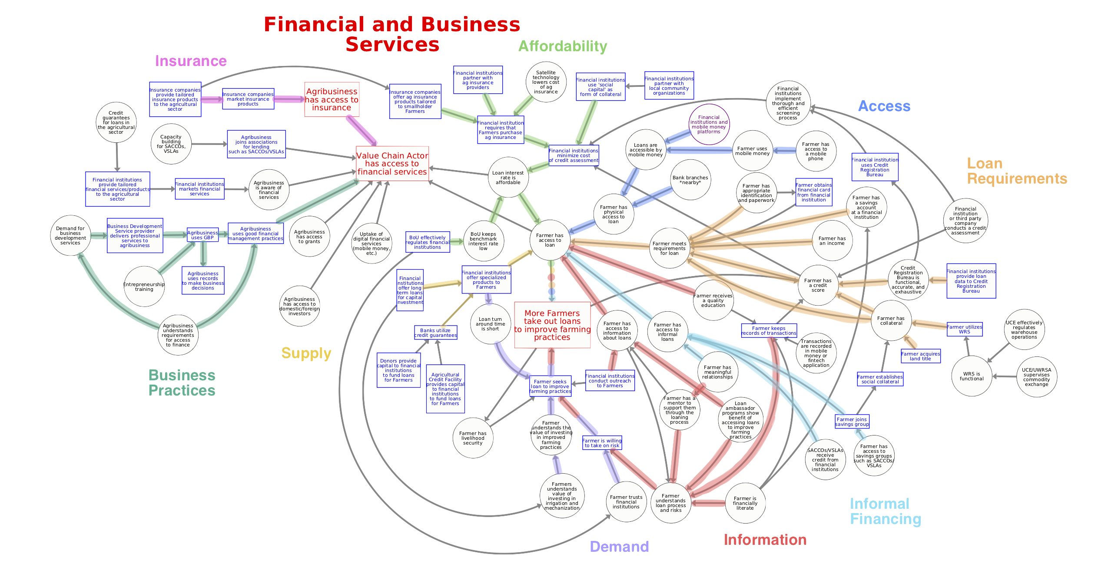
Map the system
Find important change pathways
Select leverage points
Select outcome to change
Prioritize leverage points

Slide 115
Select an outcome to change
Map the system
Find important change pathways
Select leverage points
Select outcome to change
Prioritize leverage points
Focus on a particular subsystem and select a key outcome

Slide 116
Map the system
Find important change pathways
Select leverage points
Select outcome to change
Prioritize leverage points

Slide 117
Find important change pathways
Map the system
Find important change pathways
Select leverage points
Select outcome to change
Prioritize leverage points
Identify key pathways that influence the outcome of interest.
Consider which pathways are already functioning well and which are further from their ideal state.
Consider which pathways are essential to driving change in the outcome.
  There may be multiple pathways influencing a single key outcome. Are some more important than others?
Consider whether there are barriers to change on any of the pathways.
  Are any pathways acting as inhibitors and/or counteracting the progress made on other pathways?

Slide 118
Map the system
Find important change pathways
Select leverage points
Select outcome to change
Prioritize leverage points

Slide 119
Select potential leverage points along the pathways
Map the system
Find important change pathways
Select leverage points
Select outcome to change
Prioritize leverage points
Key considerations:
Gaps: | Are there major gaps in the current portfolio that need to be addressed?
Feasibility: | Is change currently feasible? Are there resource/capacity/political constraints?
Evidence: | Have similar interventions been successful in the past? Is data or other evidence available?
Capabilities: | Where is it appropriate for USAID to intervene? Does this match our strengths & capabilities?

Slide 120
Select potential leverage points along the pathways
Map the system
Find important change pathways
Select leverage points
Select outcome to change
Prioritize leverage points
Key considerations:
Scale: | If considering a market facilitation intervention, are spillover/multiplier effects possible at this leverage point?
Scope: | At what level would we intervene? National, district-level, local?
Complementarity: | Are other interventions working on the same pathway? Are there benefits to “piling on”?
Consequences: | Are there potential positive or negative externalities? Unintended consequences?

Slide 121
Map the system
Find important change pathways
Select leverage points
Select outcome to change
Prioritize leverage points
Intervention
already exists
Support financial institutions to conduct outreach
Capacity building for financial institutions to teach
record-keeping to farmers
Support pilot of Warehouse Receipt System in a district

Slide 122
Prioritize leverage points
Map the system
Find important change pathways
Select leverage points
Select outcome to change
Prioritize leverage points
Key considerations:
Capabilities: | Does USAID already have the tools, capabilities, or relationships to intervene at this point?
Coverage: | Are other donors/NGOs/GOU already working on this pathway? Would certain interventions be complementary/additive?
Timing: | Is timing or sequencing of interventions important? Short-term vs. long-term priorities?
Impact: | Is it important to consider impact per dollar/return on investment?
Confidence: | Do we have evidence that change is possible? What are the explicit/implicit assumptions we are making? Do we have data or evidence to back up our prioritization?

Slide 123
Map the system
Find important change pathways
Select leverage points
Select outcome to change
Prioritize leverage points
3
Intervention
already exists
Support financial institutions to conduct outreach
Sequencing: plan for later
1
2
Capacity building for financial institutions to teach
record-keeping to farmers
Support pilot of Warehouse Receipt System in a district

Slide 124
Activities
Module: Leverage points
Sub-module: Identifying and prioritizing leverage points

Slide 125
Facilitator Instructions
Purpose of this module:
This module provides activities to put learnings on leverage points into practice.
Guidelines:
None
Slides in this module:
Activity: Identifying leverage points
Activity: Prioritizing leverage points
Activity: Learning Agenda

Slide 126
Activity: Identifying leverage points (25 min)
Brainstorm leverage points where USAID could intervene
  Look at key outcomes and the pathways that enable them
  Identify potential leverage points (behavior, relationship, or condition)
  Could be an existing leverage point (where an intervention already exists) or a new one where there’s currently a gap
  Your opportunity to provide input on where USAID should invest next!
Discuss with your group
  Evidence base for this leverage point (data/experience/intuition) – USAID will look at this
  Match to USAID’s strengths – why is this a good leverage point for a USAID investment?
  Add a star to the System Map at each leverage point

Slide 127
Activity: Prioritizing leverage points (15 min)
Put list of leverage points in priority order and document your reasoning for USAID.
Limited resources available – what should the priority investments be?
Capabilities: | Does USAID already have the tools, capabilities, or relationships to intervene at this point?
Coverage: | Are other donors/NGOs/GOU already working on this pathway? Would certain interventions be complementary/additive?
Timing: | Is timing or sequencing of interventions important? Short-term vs. long-term priorities?
Impact: | Is it important to consider impact per dollar/return on investment?
Confidence: | Do we have evidence that change is possible? What are the explicit/implicit assumptions we are making? Do we have data or evidence to back up our prioritization?

Slide 128
Activity: Learning agenda (5 min)
Was there data or evidence to support the choice and prioritization of leverage points?
What do you wish you knew now, that would have made that exercise easier?
What would you add to the Mission’s learning agenda?

Slide 129
Activities
Module: Collaboration and complementarity

Slide 130
Facilitator Instructions
Purpose of this module:
This module shows an example of two activities working in the same space and how by adding them to the map opportunities for collaboration can be uncovered.
Guidelines:
Slides in this module:
Add interventions from Activity A
Identify additional elements
Can interventions work together
Add interventions from Activity B
Are there complementary interventions?

Slide 131
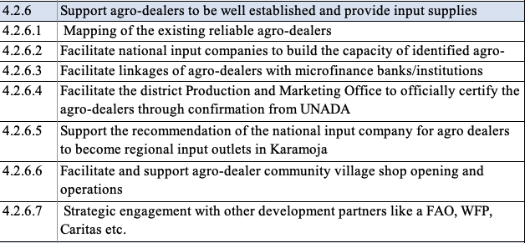
Adding selected interventions (A)
From workplan A

Slide 132
Adding selected interventions A: Identify additional elements
For impact to be sustainable, other elements may be needed

Slide 133
Adding selected interventions A: Can interventions work together?
Can we measure these elements with existing data? Or is this an information gap where we need more data, which could then reveal a leverage point? Are there opportunities for complementary interventions?
Collaboration: Can these interventions work together?

Slide 134
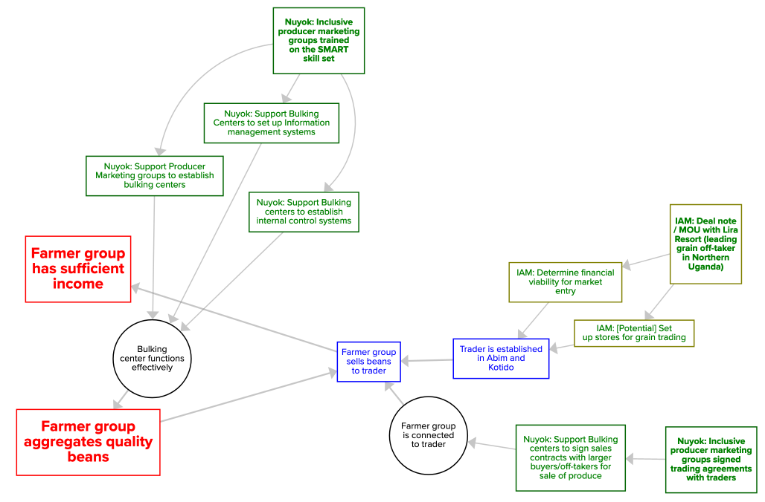
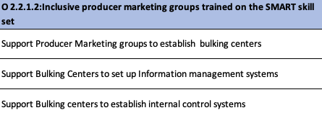
Adding selected interventions (B)
From B workplan

Slide 135
Adding selected interventions B: Are there complementary interventions?
Existing complementarity
Can we measure these elements with existing data? Or is this an information gap where we need more data, which could then reveal a leverage point? Are there opportunities for complementary interventions?
Collaboration: Can these interventions work together?

