Slide 1
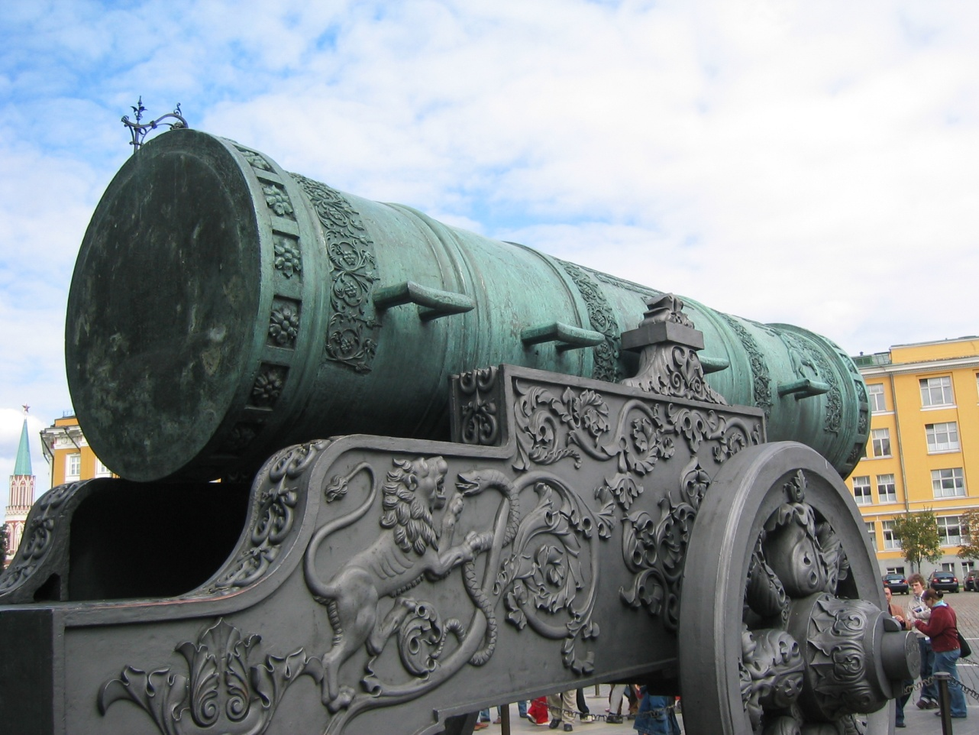
Status of high intensity polarized electron gun project at MIT-Bates
Evgeni Tsentalovich
MIT

Slide 2
General Information
Polarized electron guns utilize GaAs photo cathodes.
When polarized laser beam strikes the cathode, polarized electrons are ejected.
Photocathodes must have atomically clean surface and they must be activated by heating to about 600°C and applying Cs and NF3 to the surface.
UHV conditions are required in the gun. Any traces of gases (excluding hydrogen and noble gases) poison the crystal.

Slide 3
eRHIC (Linac-ring version)
Requires a polarized electron source with an extremely high current ( at least 10 mA).
Modern state-of-the-art guns produce ~100-200 μA
Average current of ~ 1 mA achieved in tests at JLab and Mainz;
Average current of up to 10 mA achieved at Mainz with very short lifetime (needs active cathode cooling)
Main problem – ion back bombardment.
Anode hole acts like a focusing lens for ions.
Ion damage is most severe at the center of the cathode.

Slide 4
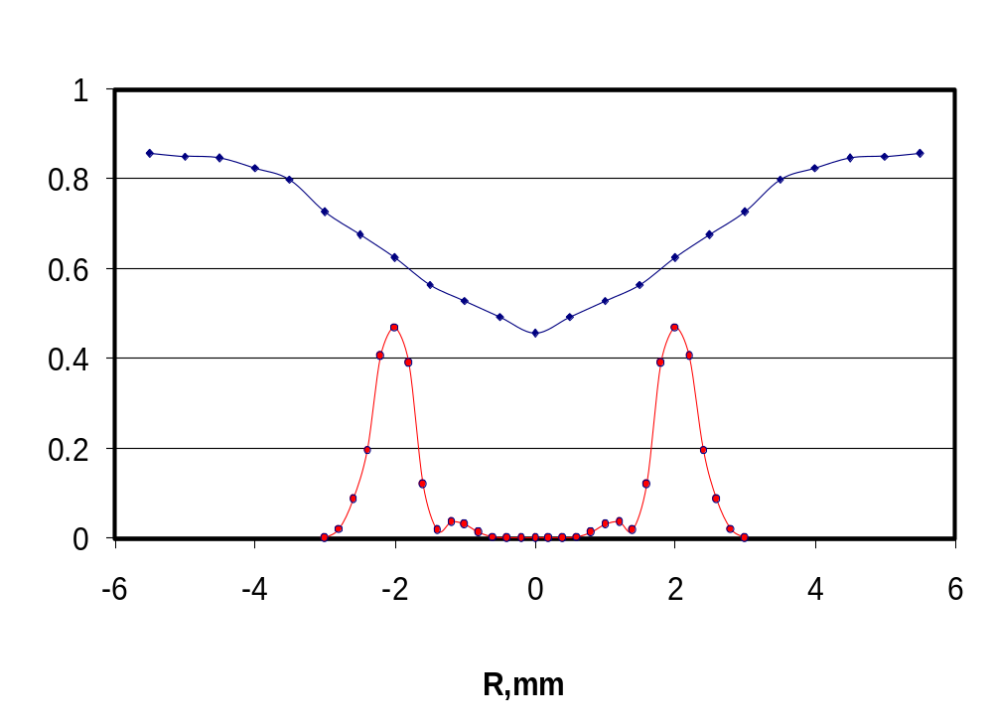
Ion damage mostly the center of cathode (Bates results)
Damage pattern
Laser beam profile

Slide 5

High Intensity Polarized Electron Gun
The principal points to achieve high average current:
Large area cathode.
Ions tend to damage the central area of the cathode – ring-shaped emission pattern.
Active cathode cooling.
Very small beam losses could be allowed near the gun ( ).

Slide 6
Additional requirements
Heat-cleaning and activation compromise vacuum condition, they should be done in a separate chamber (preparation chamber).
It takes months to achieve good vacuum, so gun chamber and preparation chamber should never be vented. New cathodes should be loaded into the system via load lock.

Slide 7
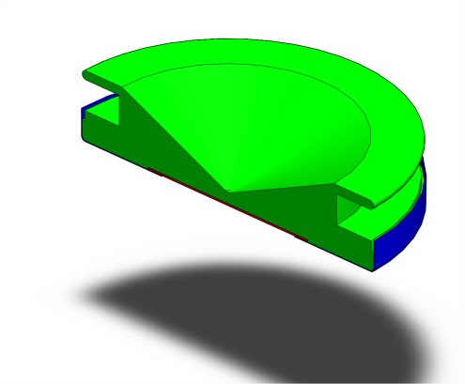
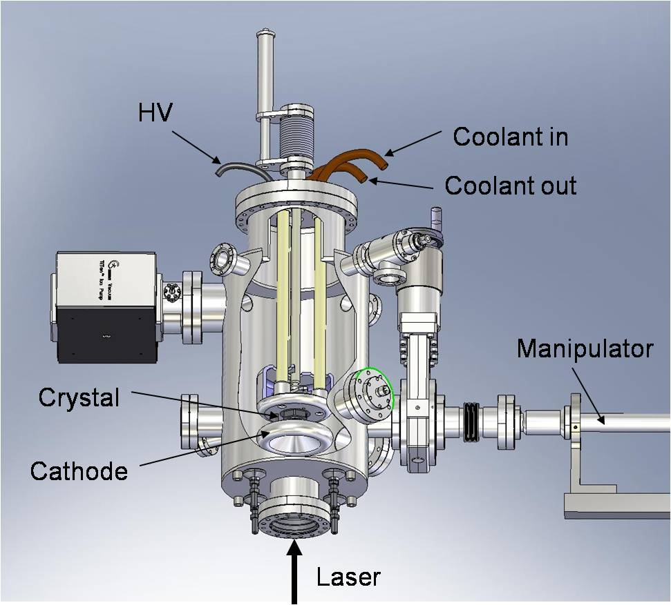
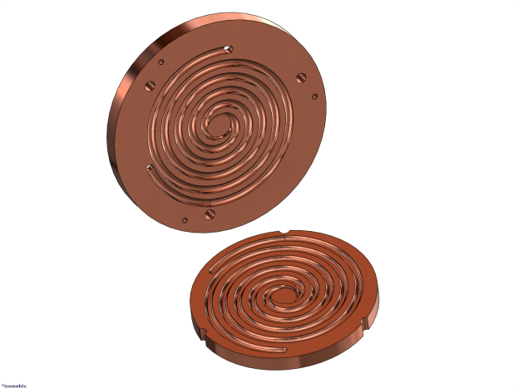
Cathode cooling
Cathode puck (Moly)
(Fluorinert)
Heat exchanger

Slide 8
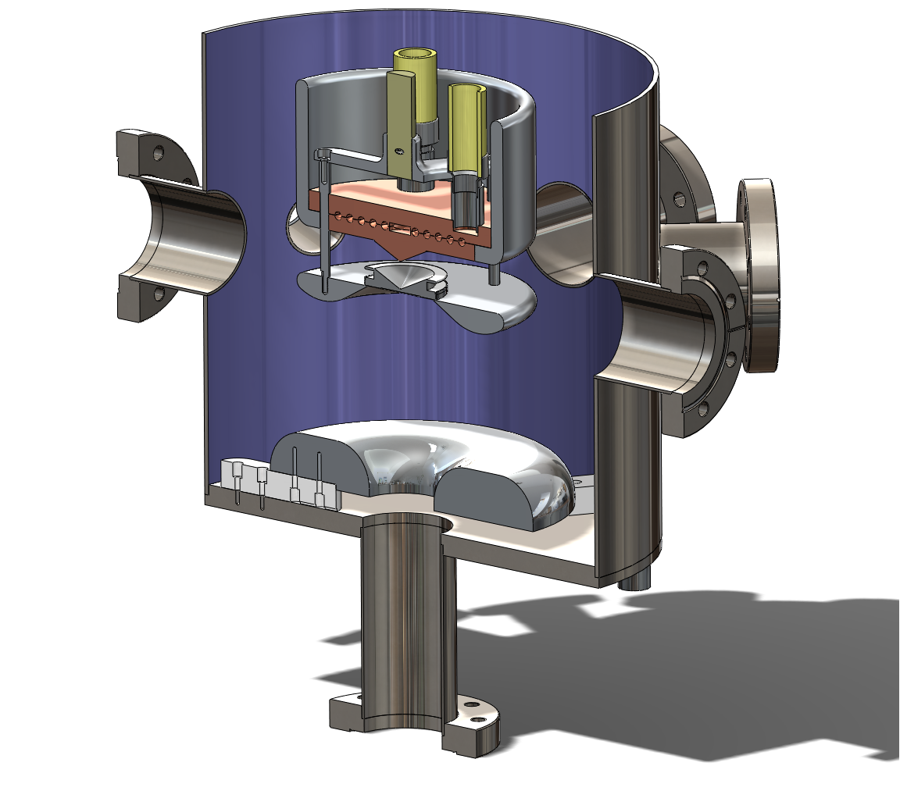
Cathode – anode assembly
Fluorinert
(cooling agent)

Slide 9
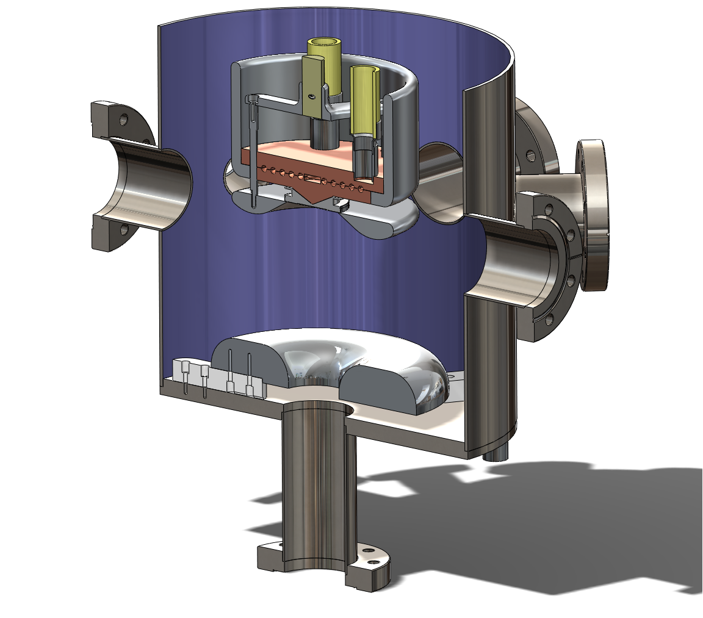
Cathode – anode assembly
Fluorinert
(cooling agent)

Slide 10
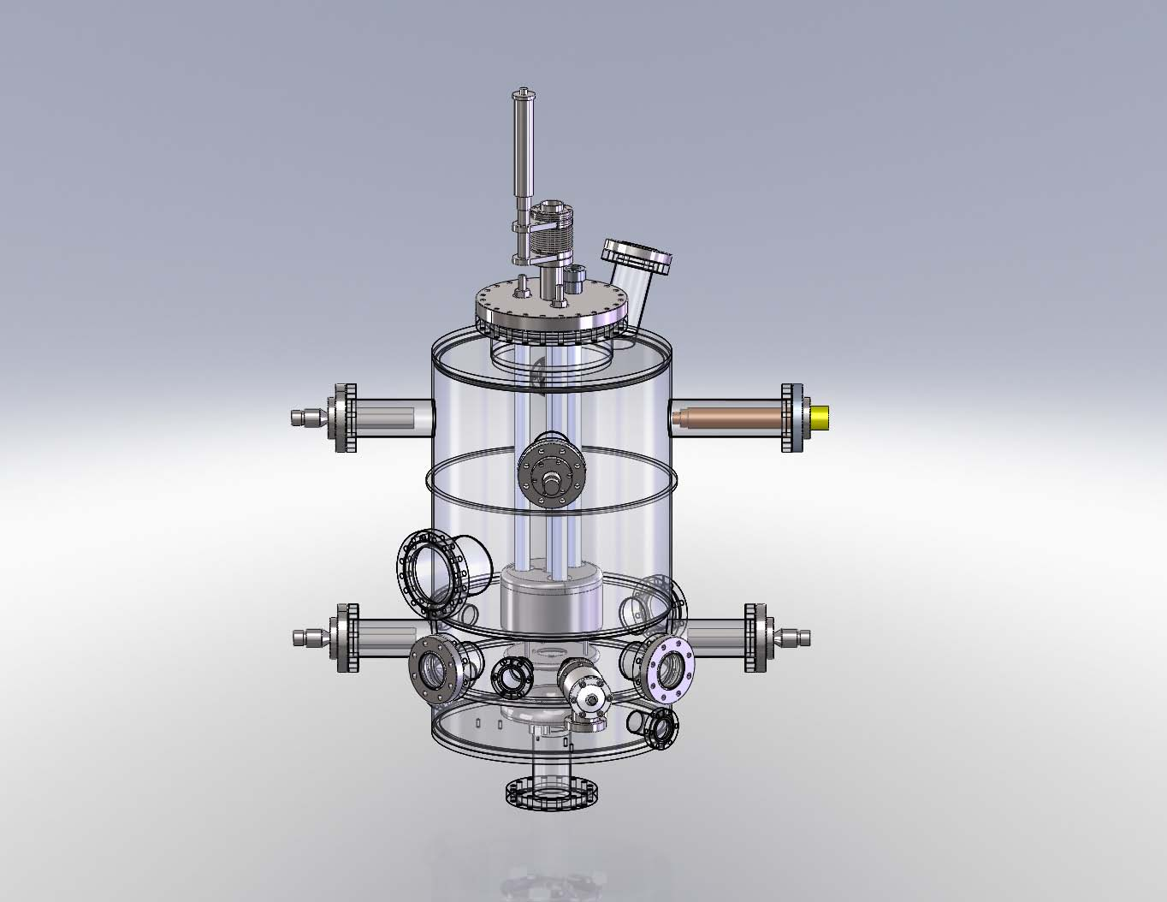
Gun chamber

Slide 11
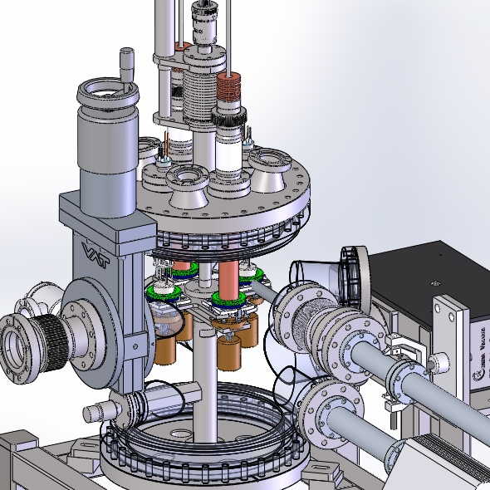
Preparation chamber

Slide 12
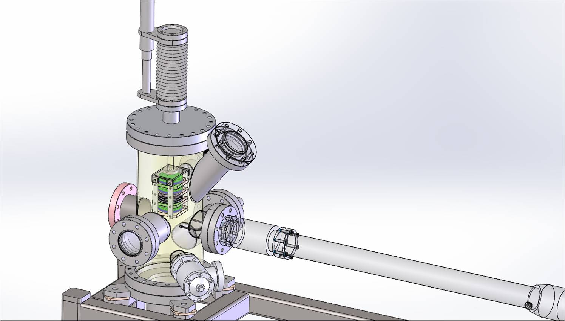
Load lock

Slide 13
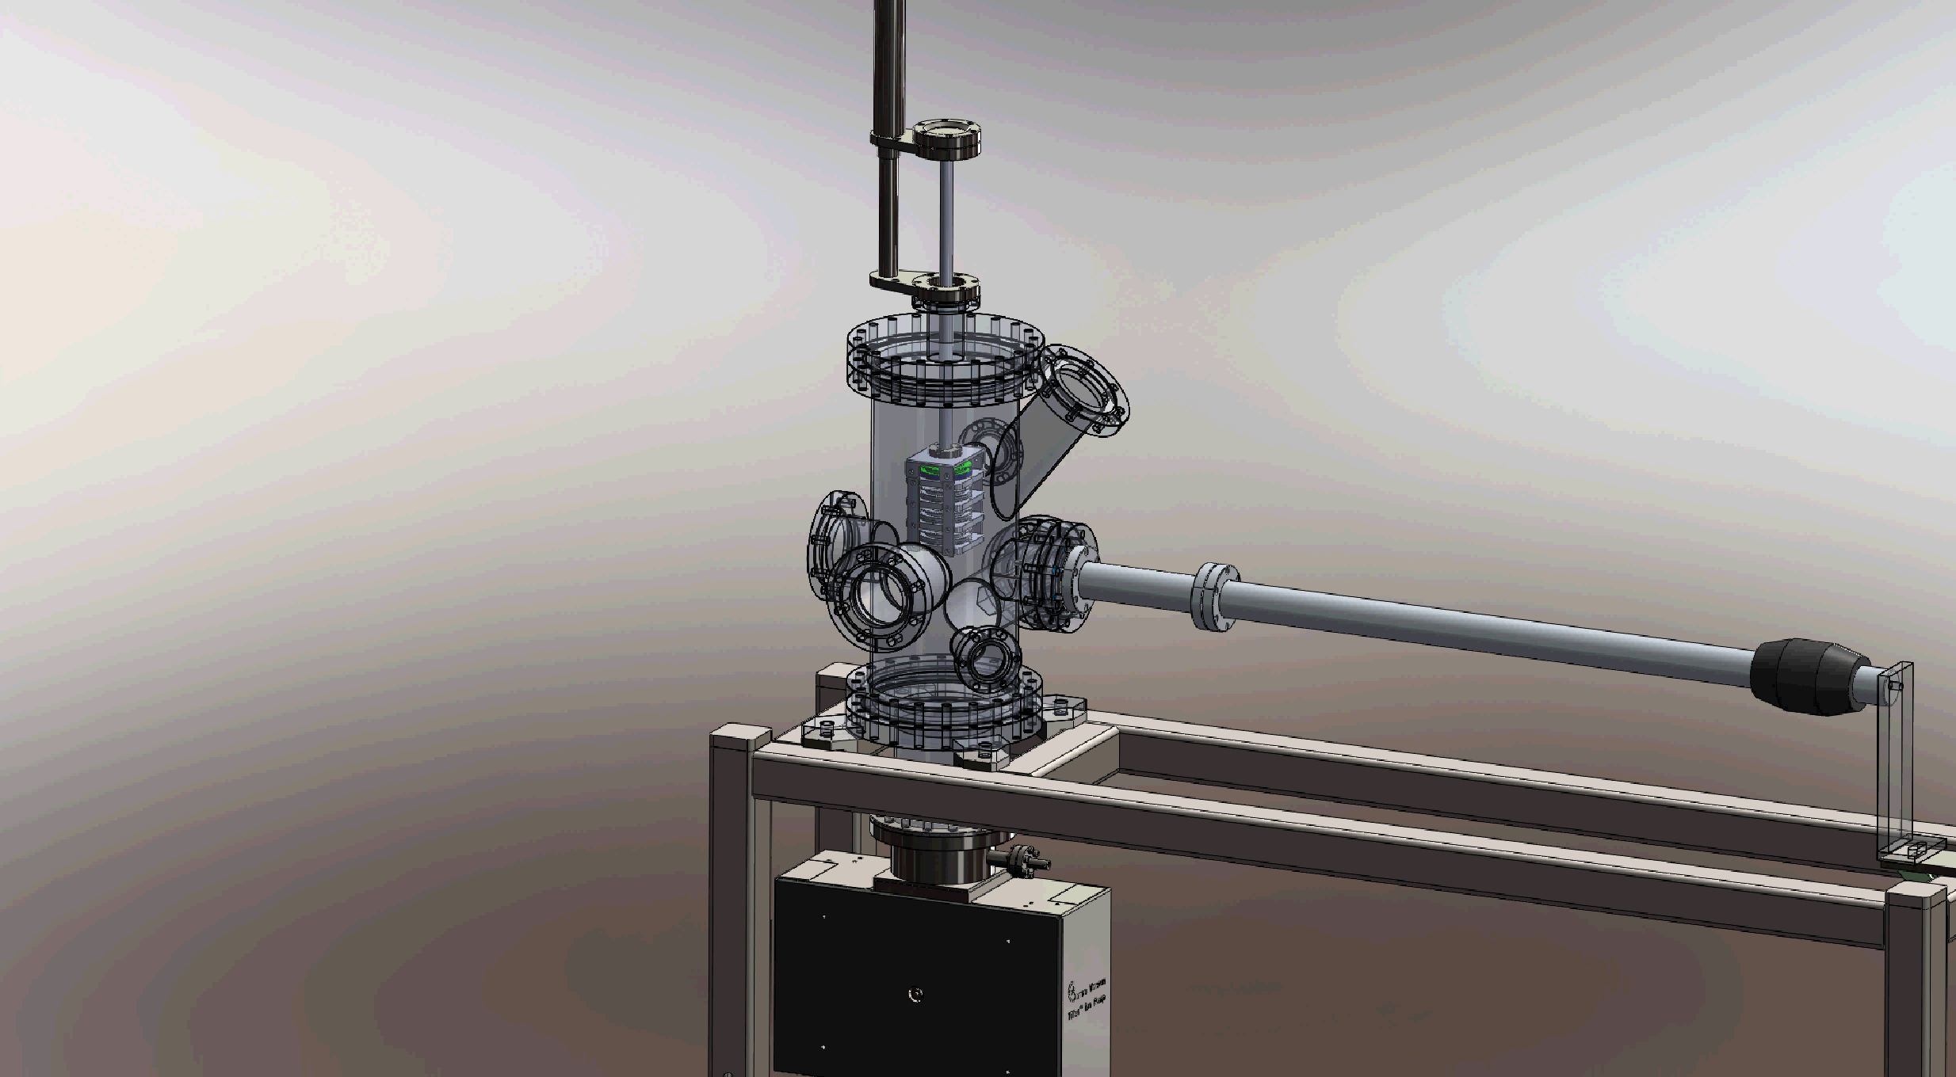

Slide 14
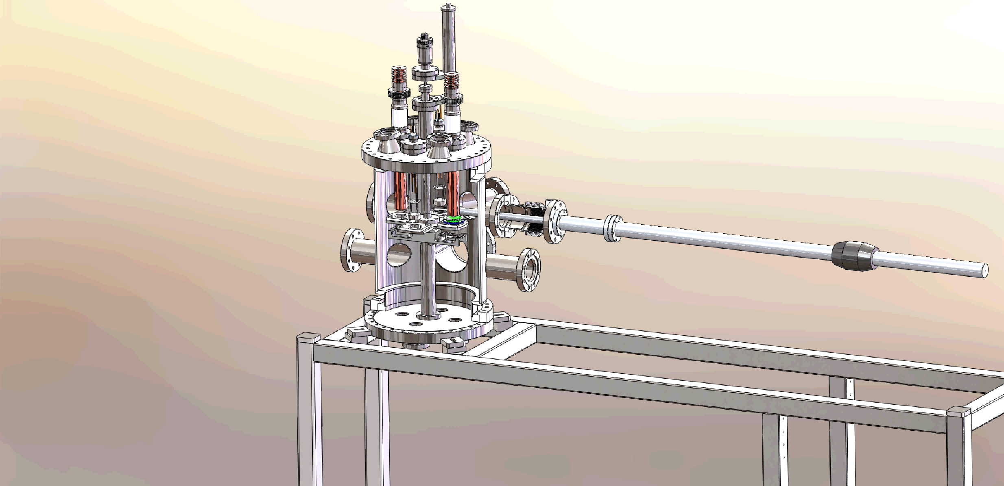

Slide 15
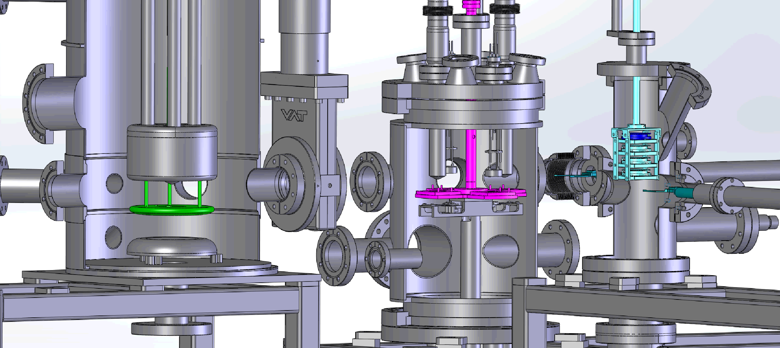

Slide 16
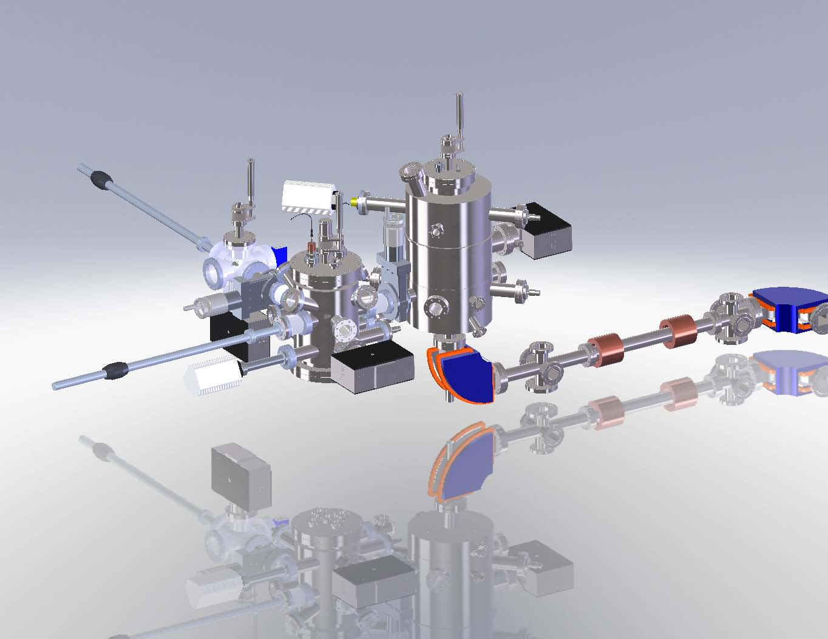
Gun + beam line

Slide 17
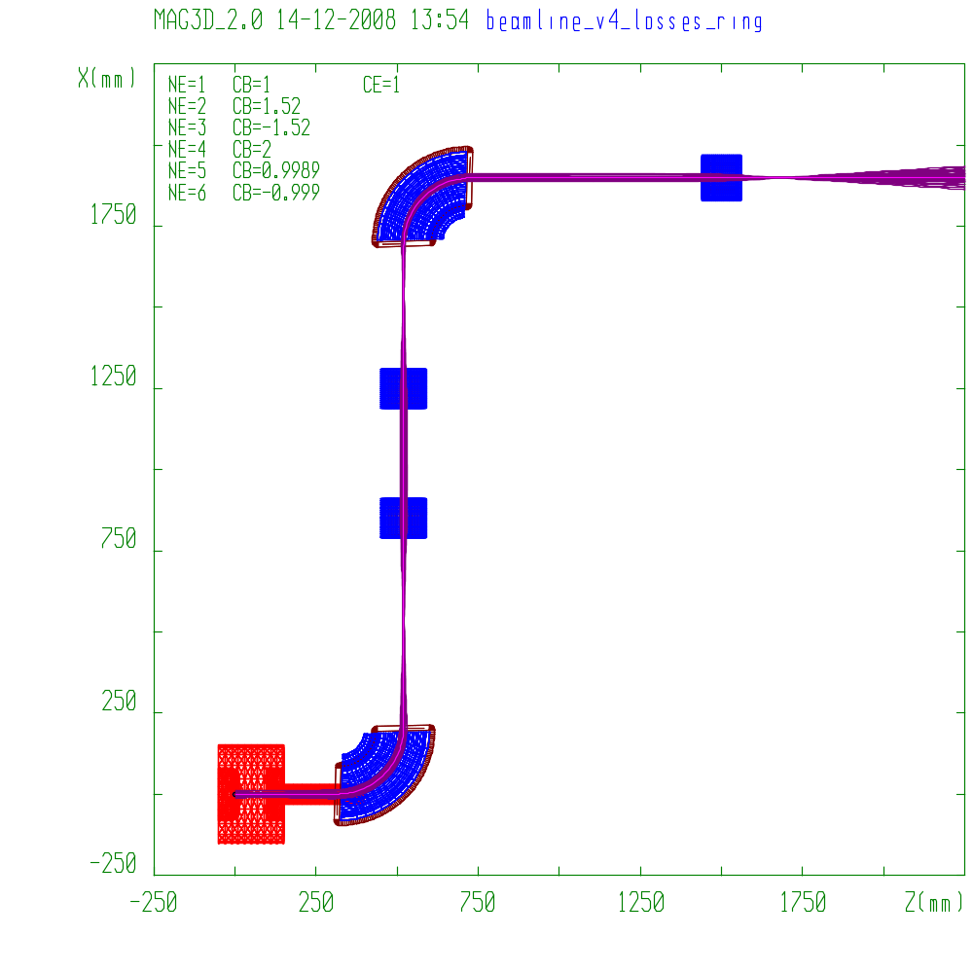
Beam line. Pipe aperture ~±34 mm.
Beam dump
Dipoles
Solenoidal
lenses
Gun

Slide 18
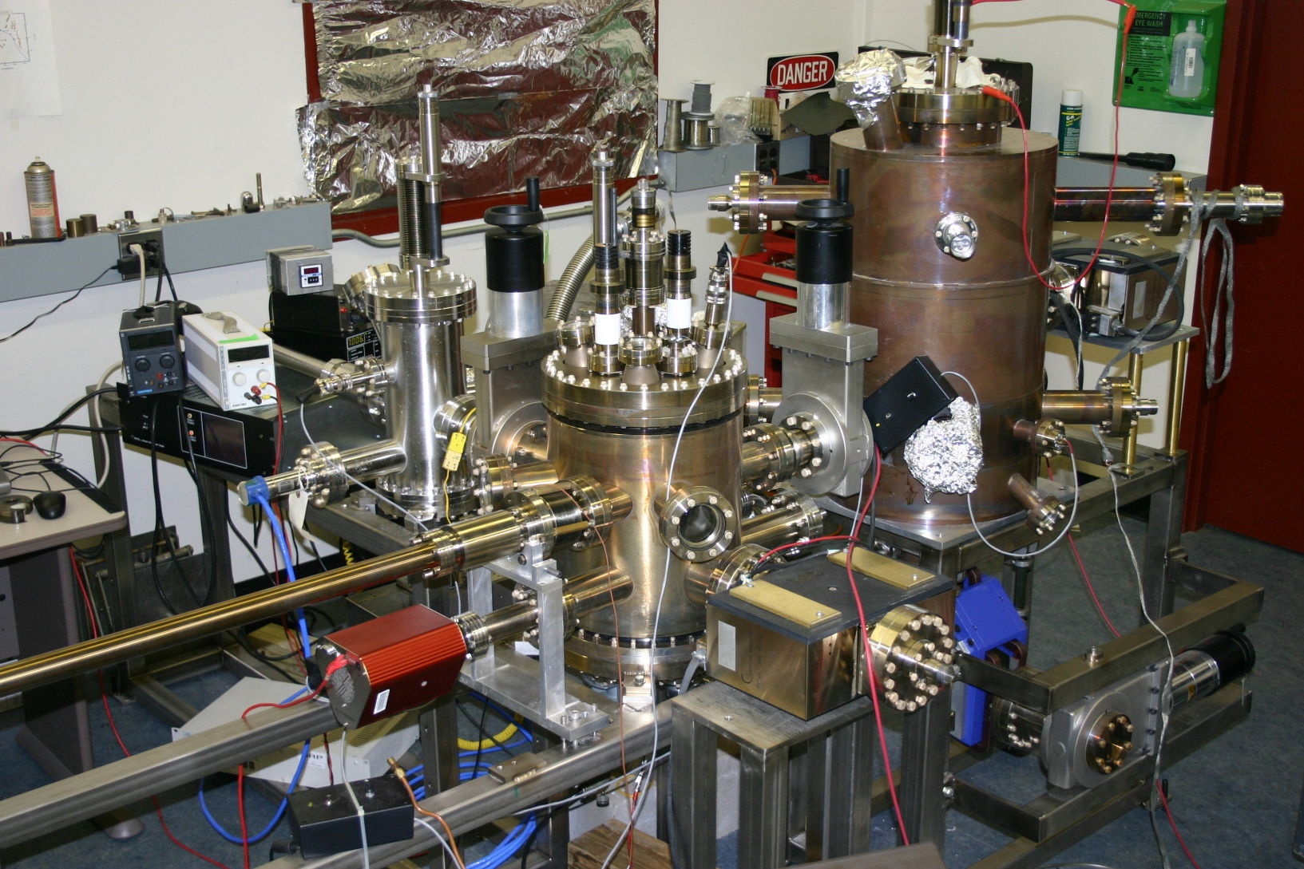
Gun + beam line

Slide 19
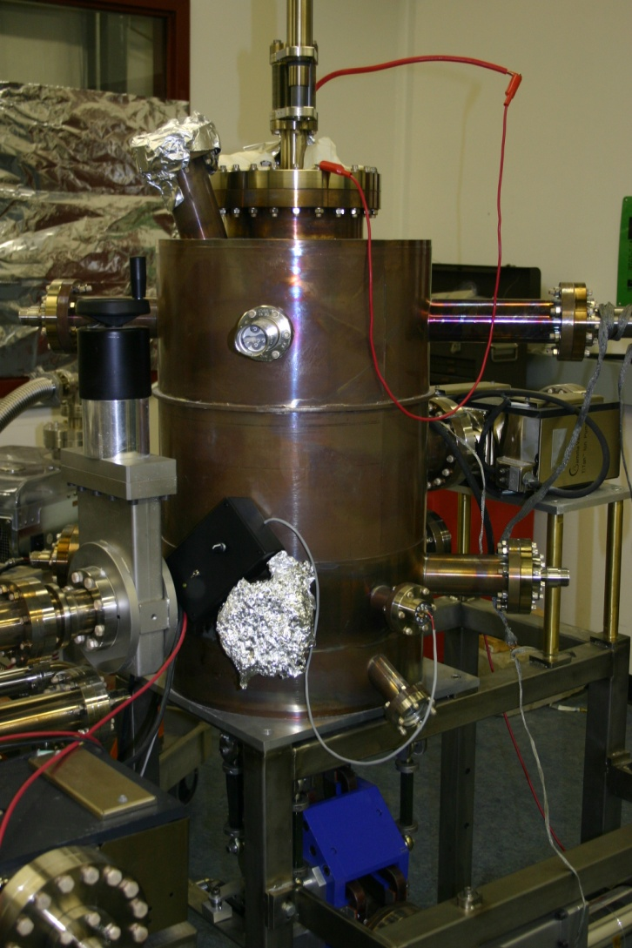
Gun chamber

Slide 20
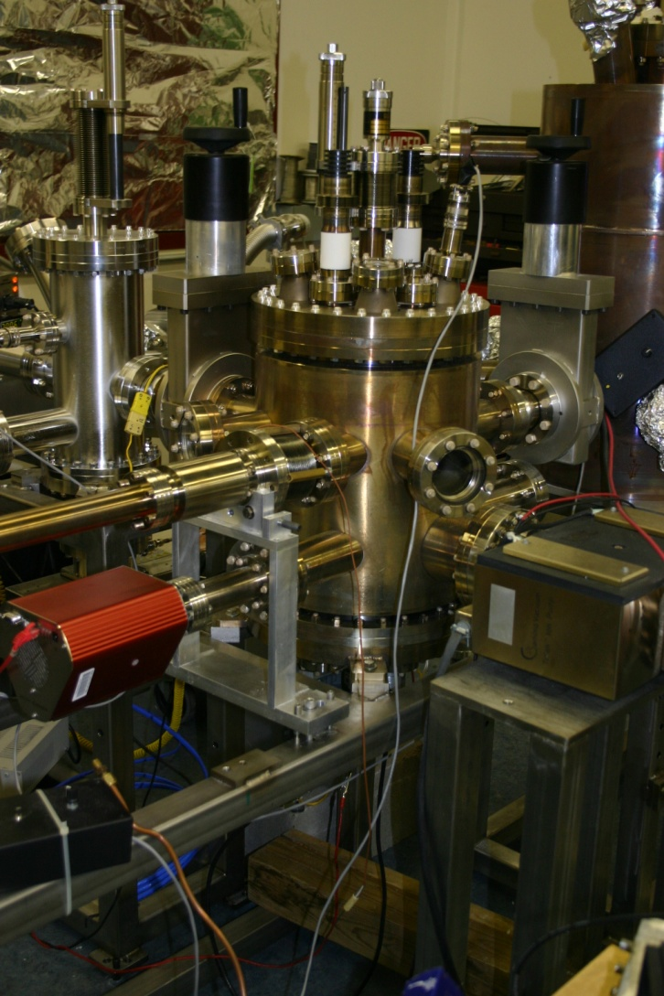
Prep. chamber

Slide 21


Vacuum features of the chambers
Gun chamber: 100 l/s Ion pump with 400 l/s NEG and 4 additional 400 l/s NEGs.
The chamber walls are thin (~ 3 mm) to reduce outgasing.
The chamber and most of the parts have been prebaked to 400°C before the final assembly.
Bake-out at 250°C after the final assembly.
Vacuum ~ (all Hydrogen)
Prep. chamber: 100 l/s Ion pump with 400 l/s NEG and 2 additional 400 l/s NEGs.
Vacuum ~ (all Hydrogen)

Slide 22
BUDGET
FY | From BNL | From DOE | Actual cost to date
07-09 | $444 K |  | $444 K
10-11 | $150 K | $586 K | $736 K
12-13 |  | $388 K | $388 K
14-15 |  | $500 K | $197 K
Total | $594 K | $1474 K | $1765 K

Slide 23
PROJECT PROGRESS
FY 2007-2009 - preliminary simulations and tests. Beam simulations through the gun and entire beam line. Emphasis – no beam losses near the gun. Tests of active cooling. HV tests.
FY 2010-2011 – gun chamber and preparation chamber built and assembled. Load lock and beam line designed, and manufacturing began.
FY 2012-2013 – load lock build and assembled. Beam line and unbiased beam dump built.
FY2014-2015 – beam line and beam dump completed. First beam tests.

Slide 24
PROJECT PROBLEMS
Gun chamber, preparation chamber, load lock manufacturing and assembly – not a glitch. Excellent vacuum conditions. Reliable cathode transfer between chambers (good illumination and observation conditions). Very high QE (~2% at λ=805 nm) has been achieved. However, the dark lifetime of the cathode in the gun is short (less than 100 hours).
Beam line assembly – successful. Beam tuning through the beam line – the shape of the beam in a full agreement with simulations.
Beam dump bake out – first problem. The solder in the assembly melted venting the chamber. Lost NEG. Tight budget makes such accidents time consuming (delivery time 6 weeks).
Beam tests – real problem. The lifetime is much shorter than in old generation guns even at low current.

Slide 25
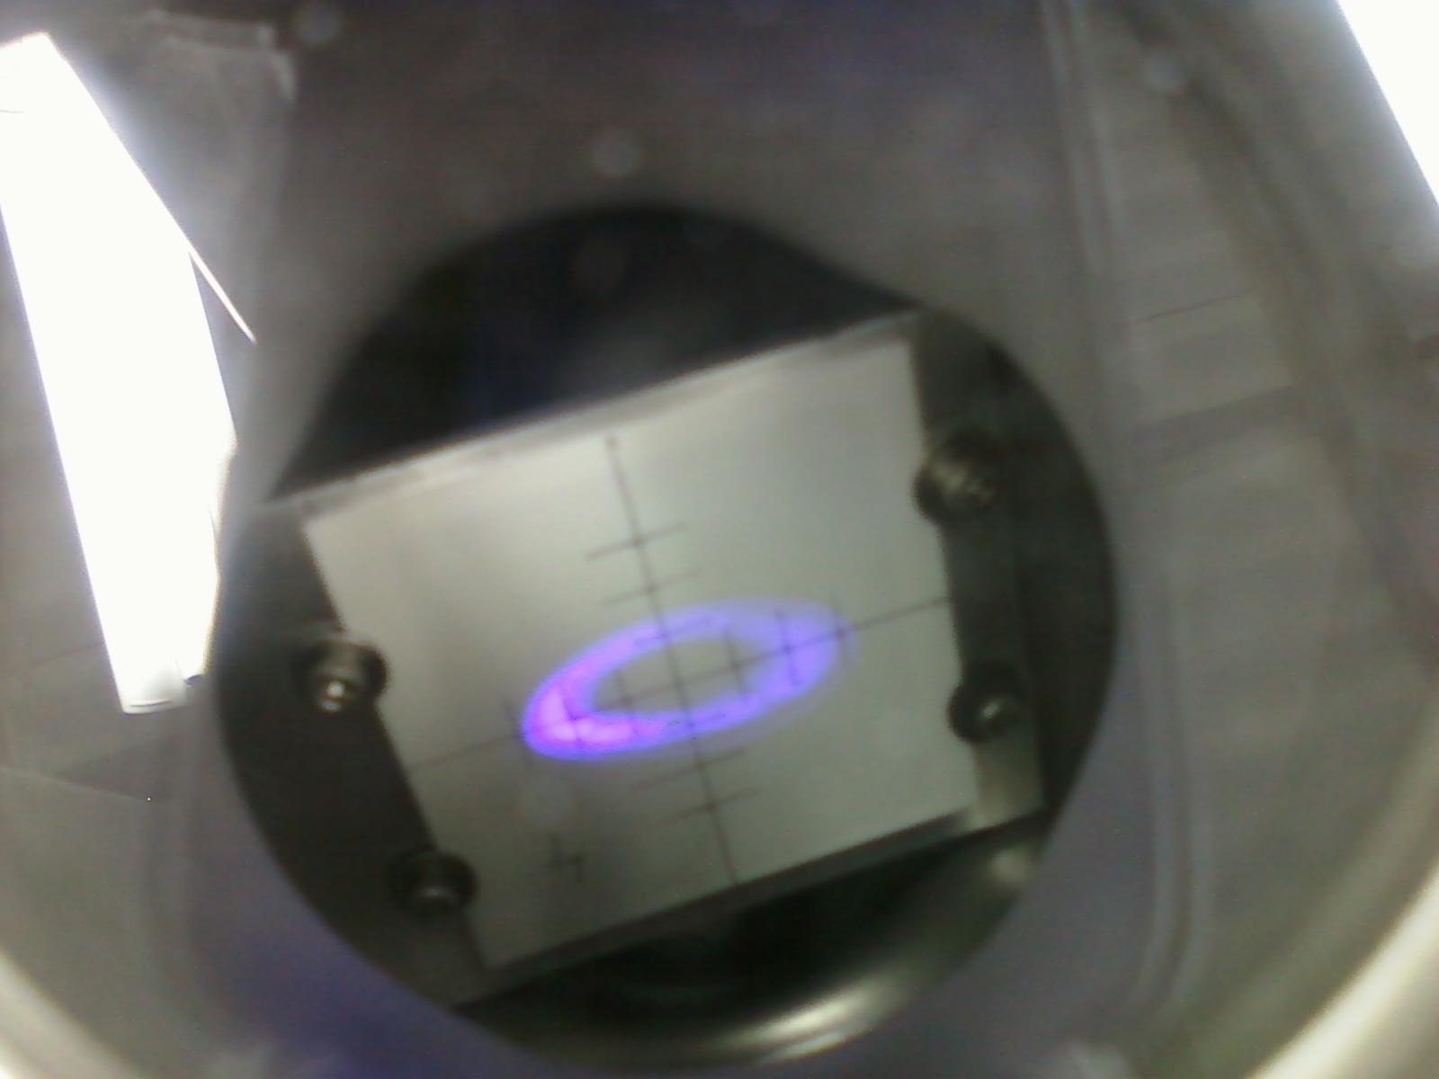
Beam on BeO target

Slide 26
SECOND TRY
Most likely the problem is a fluorinert leak into the gun chamber. The molecules ar very compact and penetrate through very narrow cracks, they are too heavy to be detected with RGA, and they are chemically active.
The gun was vented and the problem addressed. Preparation chamber was vented as well to fix minor problems. Reassembly and rebake.
A whole bunch of accidents:
Gasket failure during bake out (twice)
Magnetic manipulator support system putting pressure on the gasket during alignment, causing leak and venting both gun and preparation chamber
Ceramic support standoff for Cs strips creaked shortening the strips to the ground (another 6 weeks delivery item).

Slide 27
CURRENT STATUS
After all those problems have been solved, a fresh cathode was activated and transferred into the gun chamber for dark lifetime measurements.
The dark lifetime (was less than 100 hours) has increased to almost infinity ( at least tens of thousands hours). Whatever decease the gun had is gone.
The section of the beam line vented previously was rebaked last week.
We still need to reinstall all magnetic elements (dipoles, steering coils) and magnetic shielding.
We plan to resume beam tests in 2 weeks.

